Slide 1

Data Wrangling in R and RStudio
January 30th 2019
Old Dominion University
Virginia Modeling, Analysis & Simulation Center

Slide 2
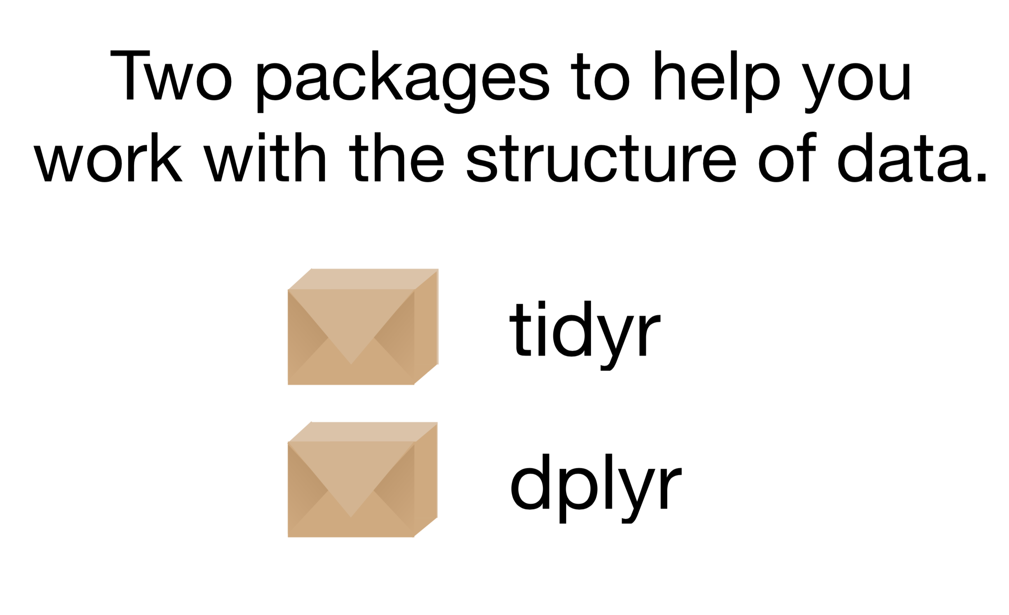
Data Wrangling Packages

Slide 3
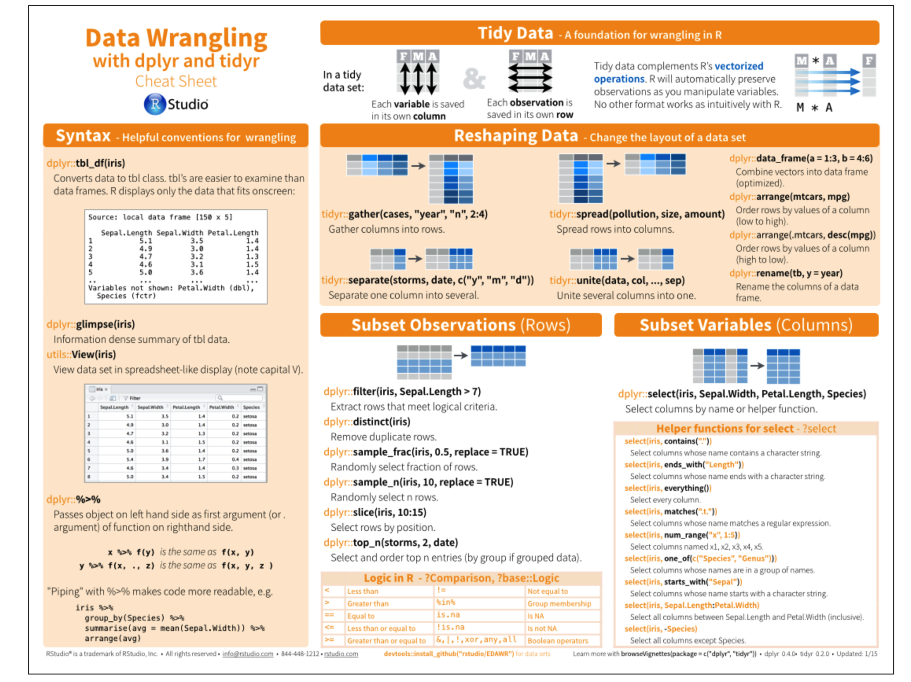
Data Wrangling Cheat Sheet

Slide 4


Data Wrangling Ground Rules

Slide 5
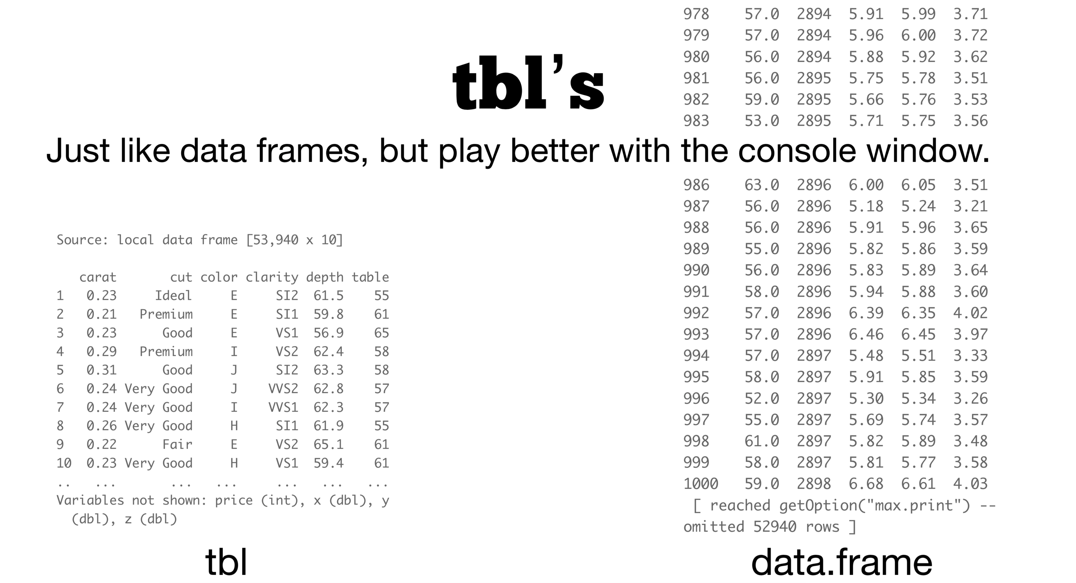
Data Wrangling: Tibble (tbl) vs. data.frames (df)

Slide 6
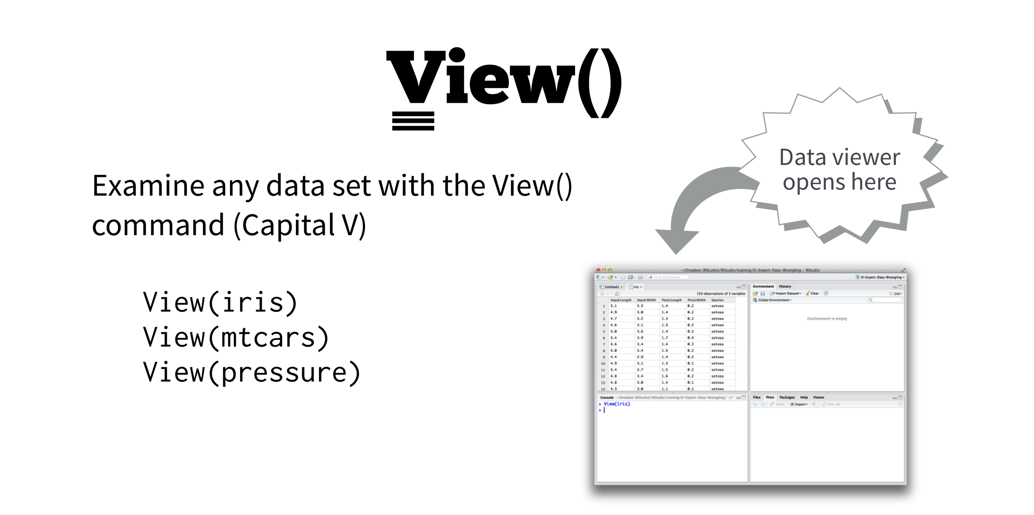
Data Wrangling: View() in RStudio

Slide 7
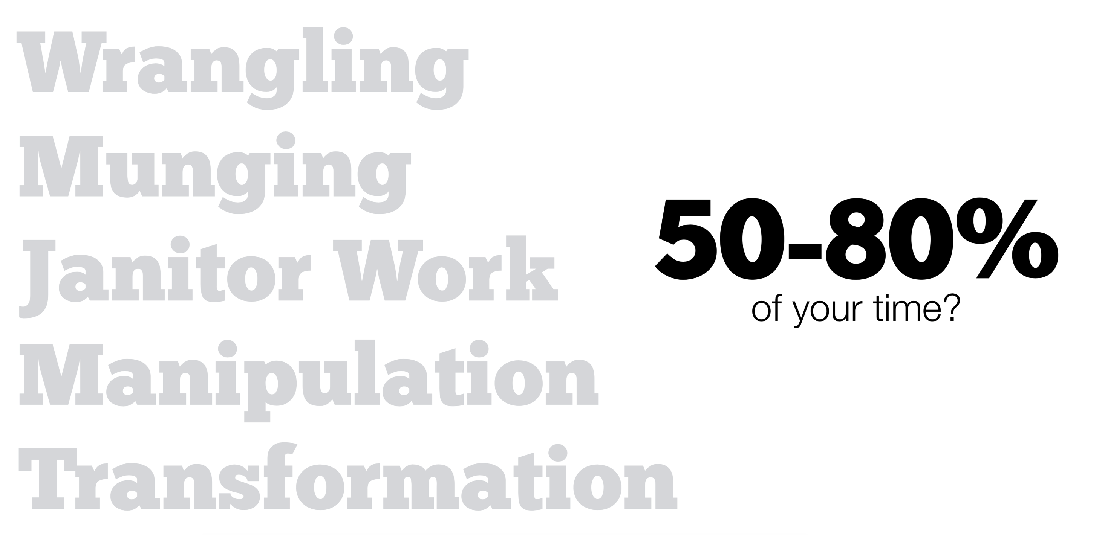
Data Wrangling: Why Its Important

Slide 8
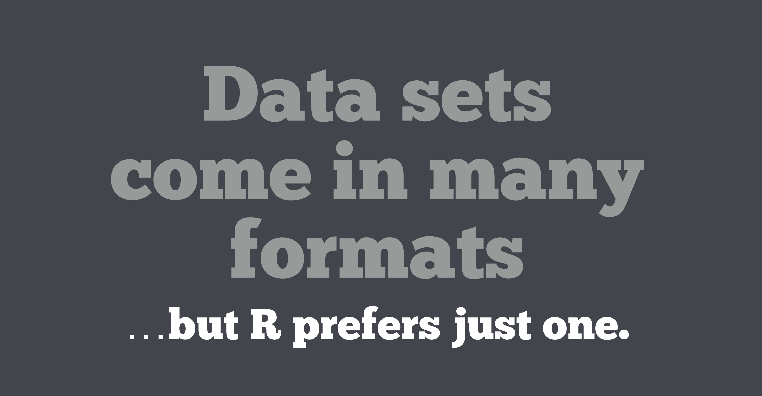
Data Wrangling: Preferred R Format

Slide 9
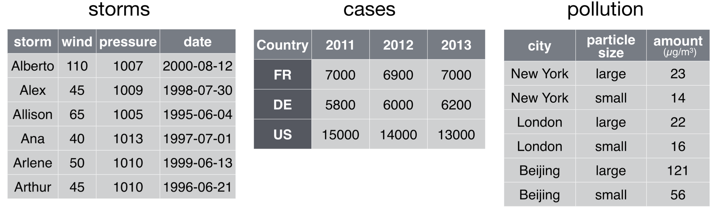
Data Wrangling: First Read In The Datasets
storms = read.csv(“datasets/storms.csv”)
cases = read.csv(“datasets/cases.csv”)
pollution = read.csv(“datasets/pollution.csv”)

Slide 10
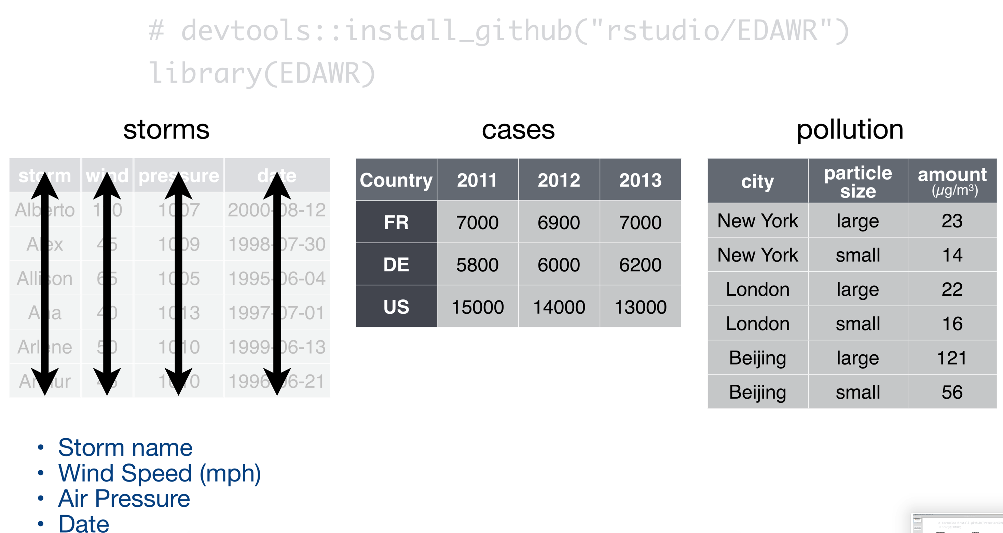
Data Wrangling: Example Datasets

Slide 11
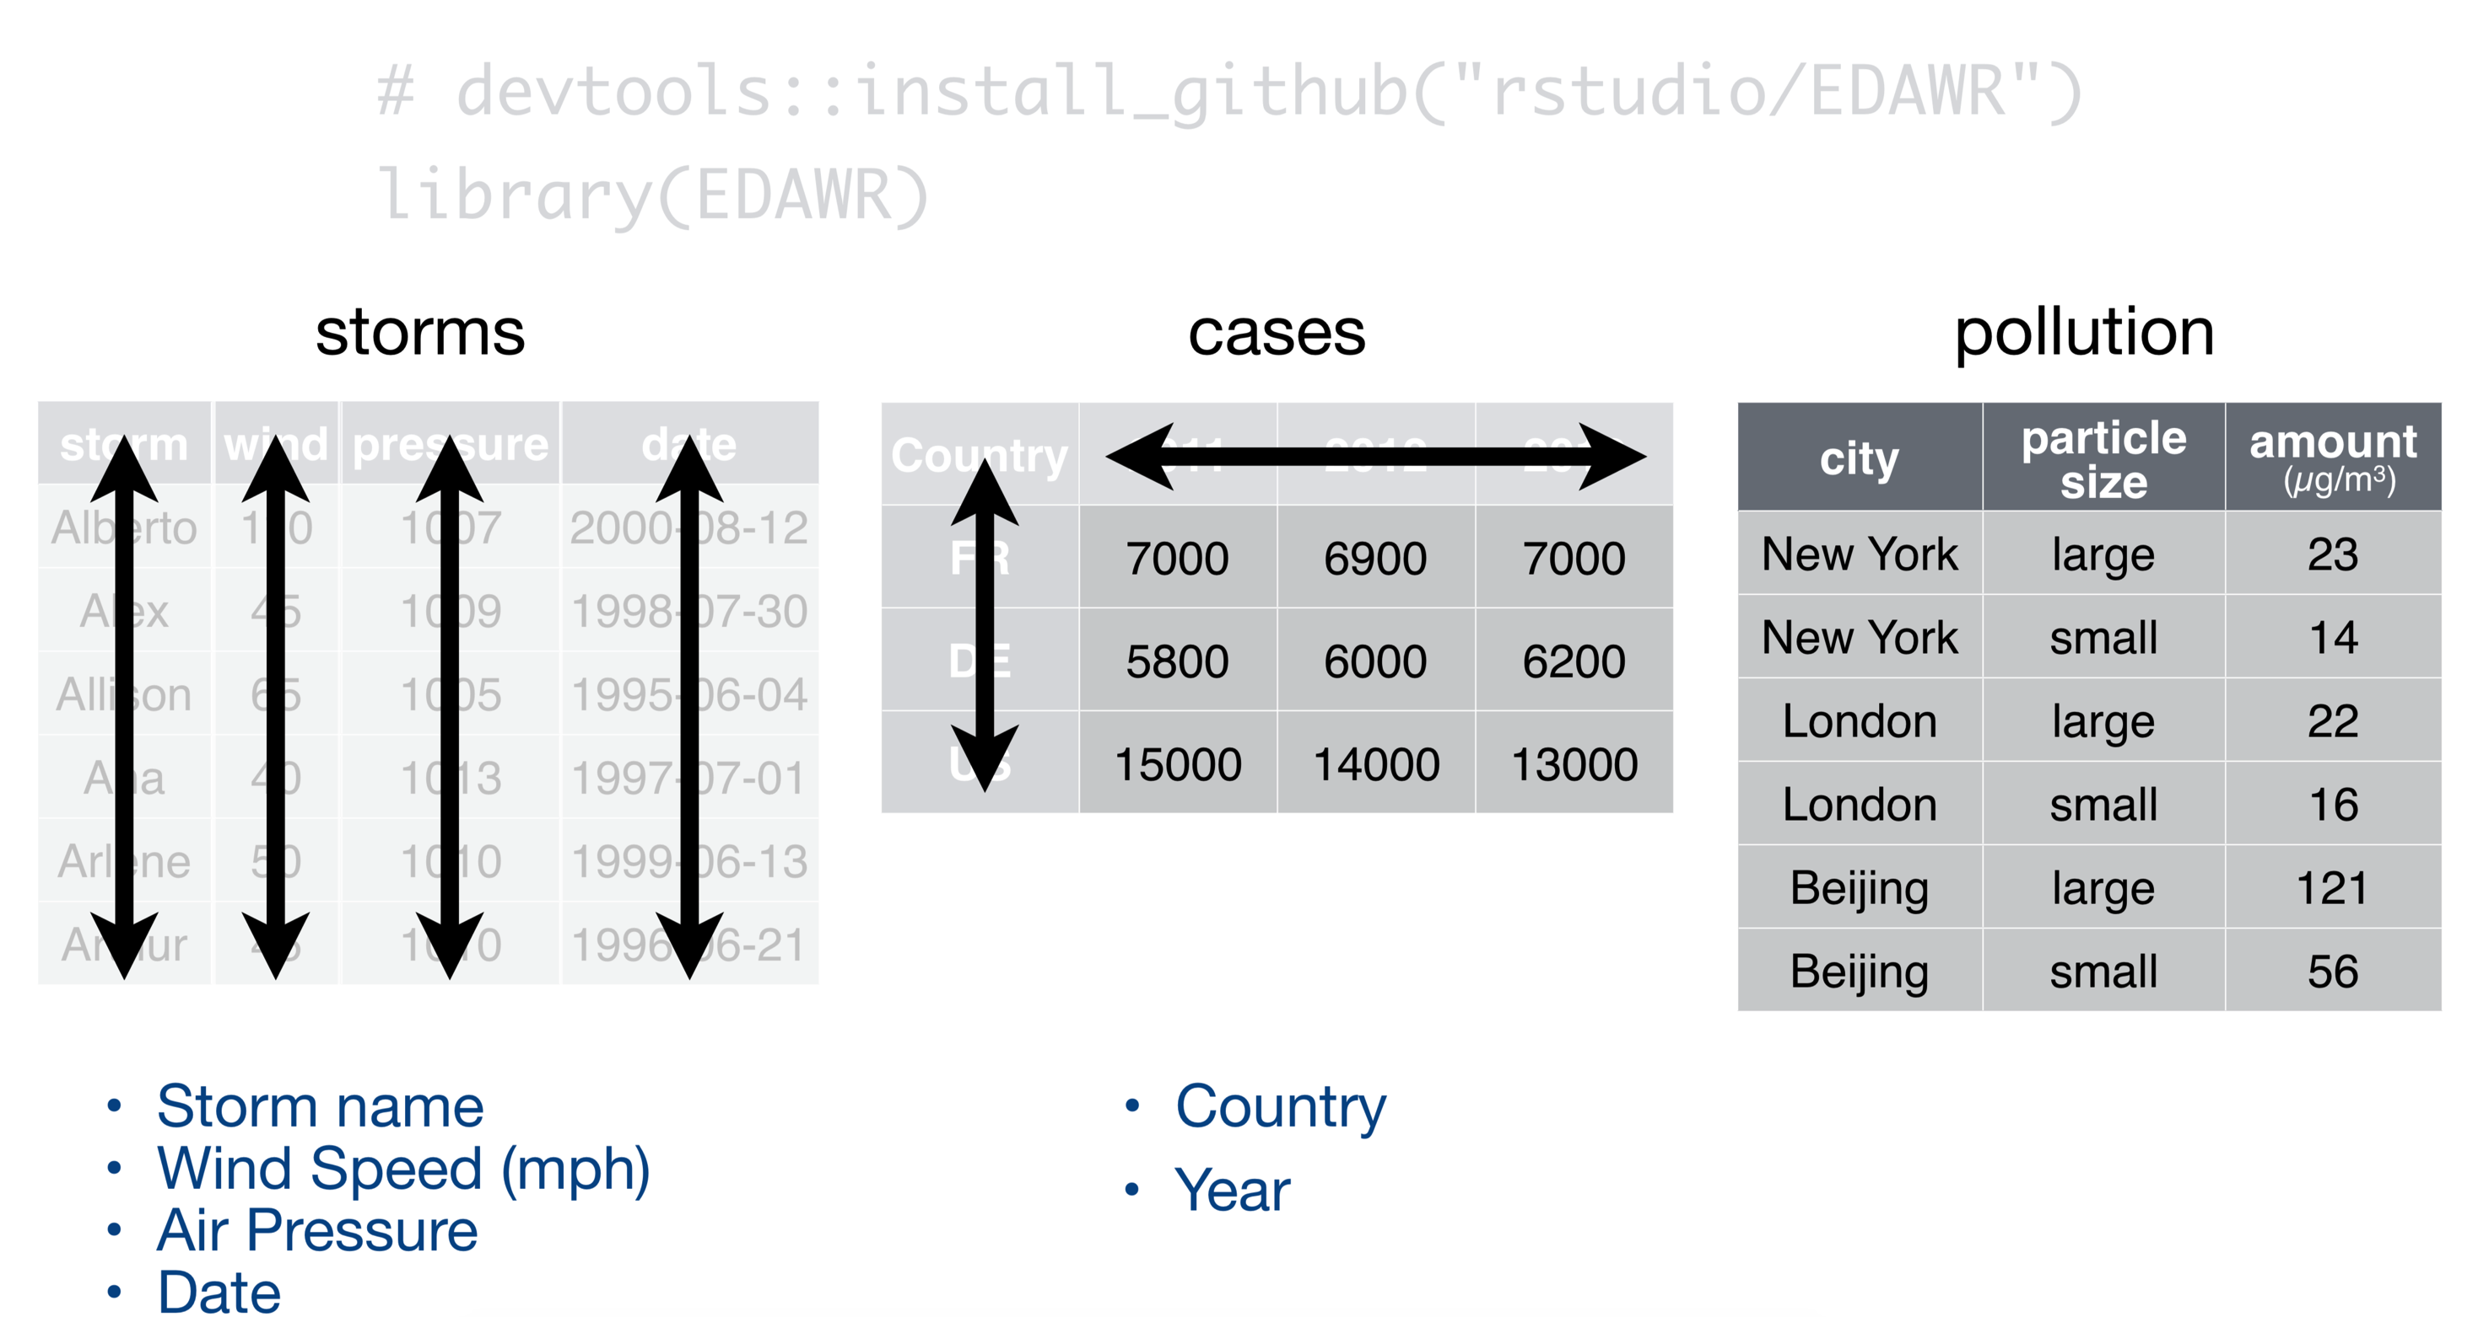
Data Wrangling: Example Datasets

Slide 12
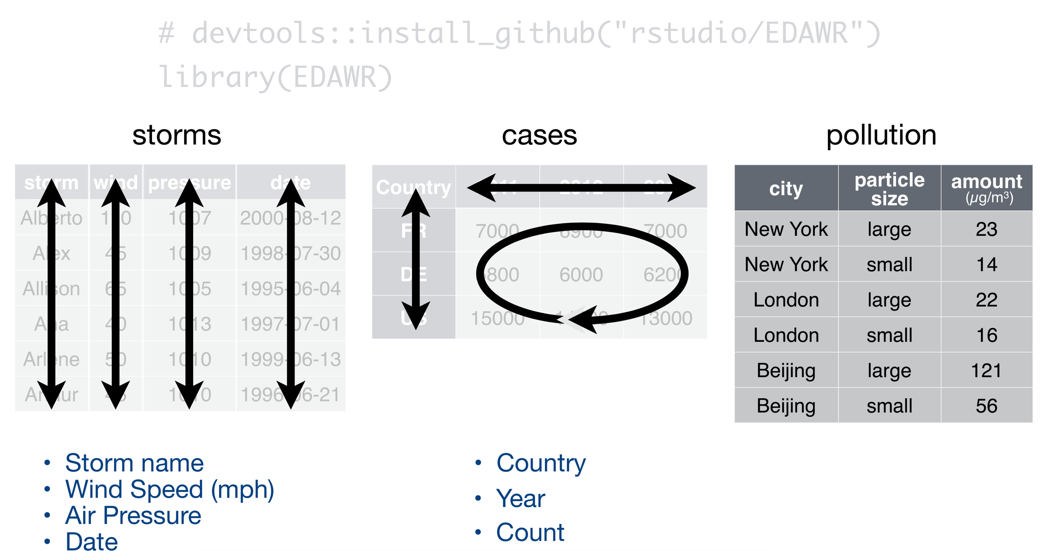
Data Wrangling: Example Datasets and EDAWR package

Slide 13
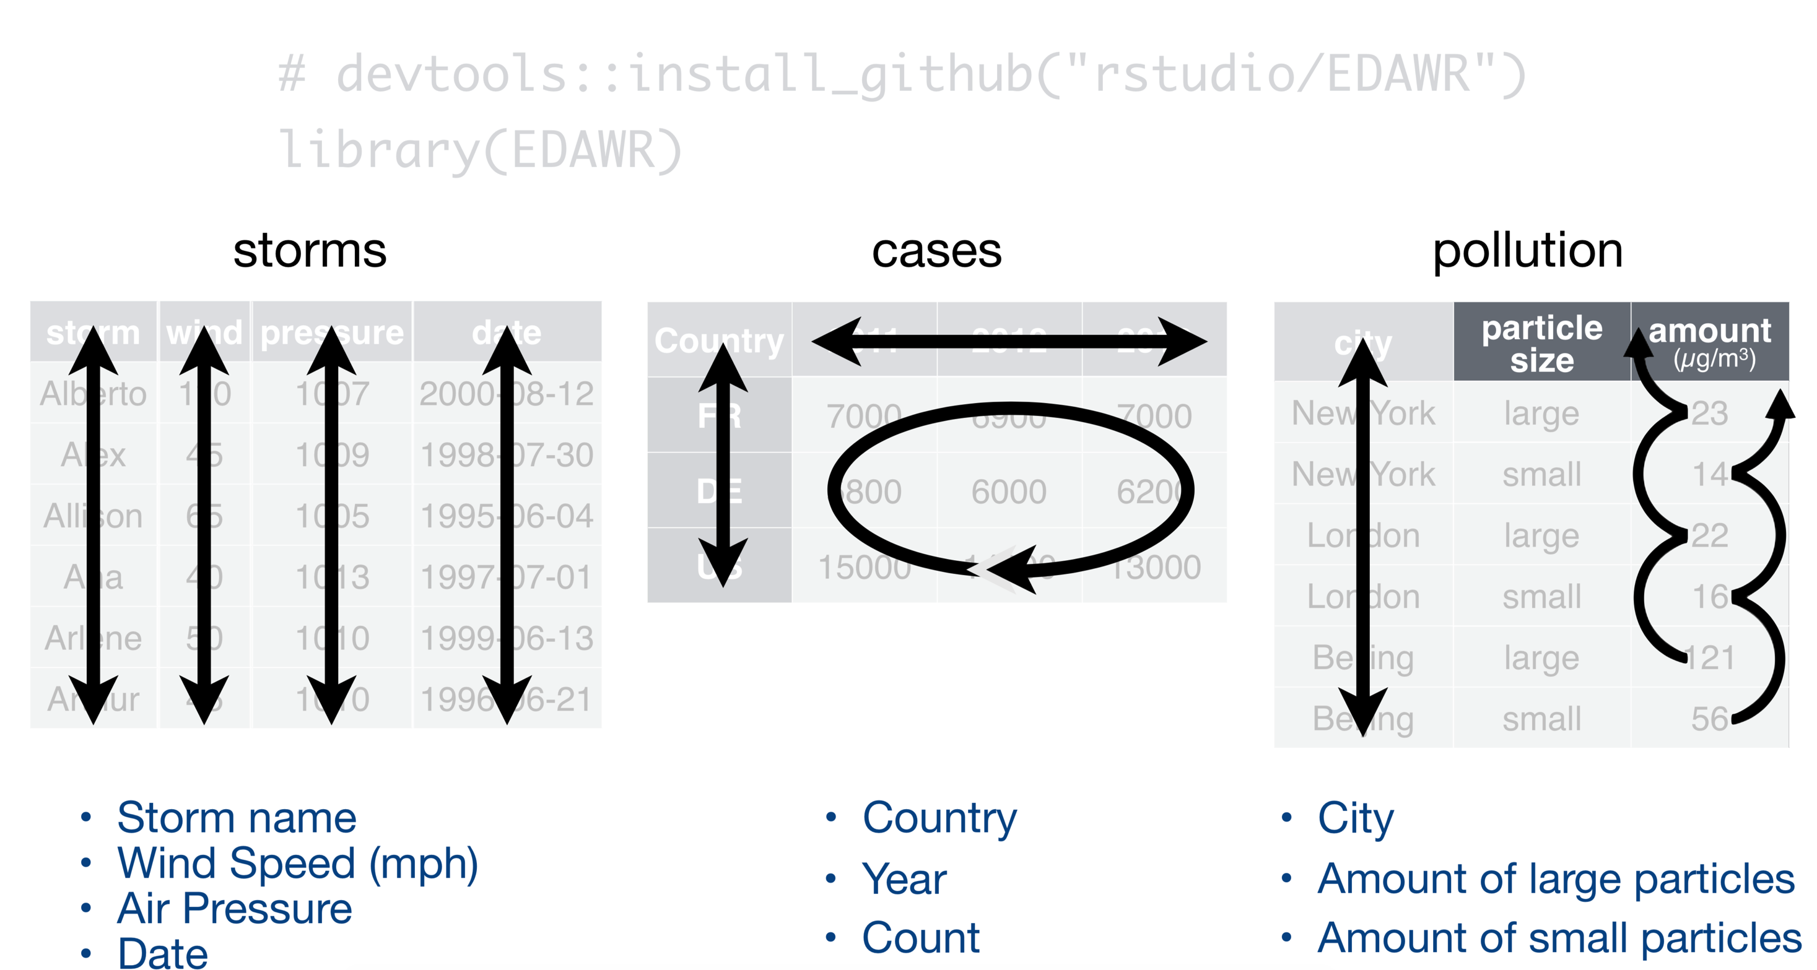
Data Wrangling: Example Datasets and EDAWR package

Slide 14
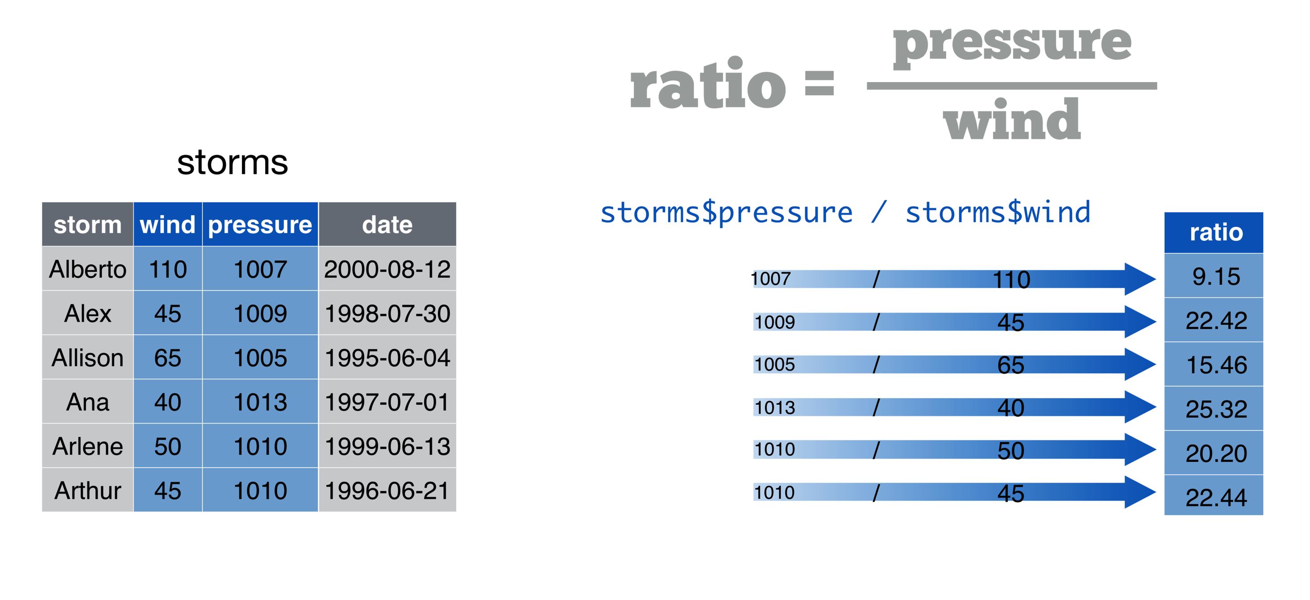
Data Wrangling: Example Datasets and EDAWR package

Slide 15
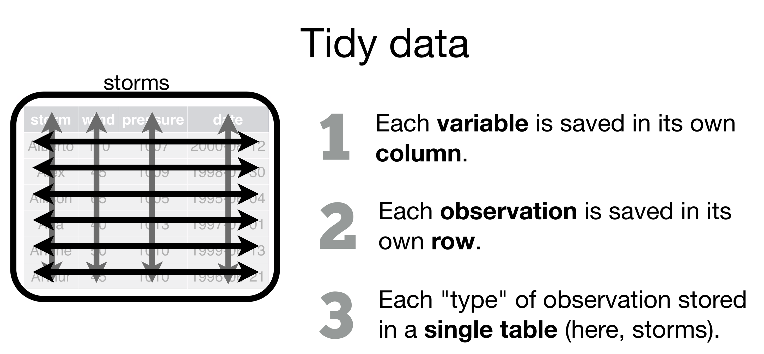
Data Wrangling: Tidy data

Slide 16


Data Wrangling: tidyr

Slide 17
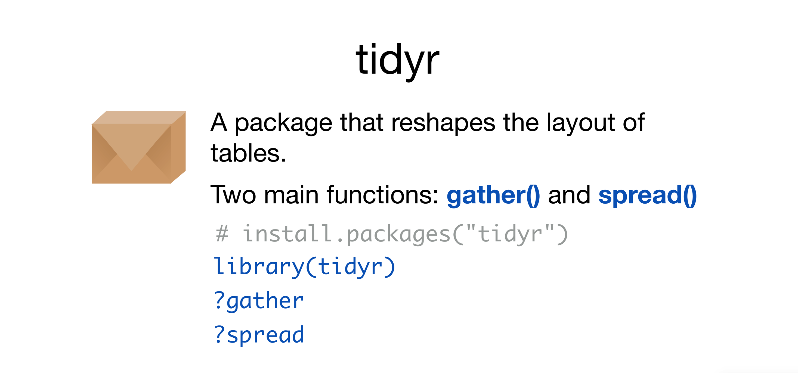
Data Wrangling: Tidy data with tidyr

Slide 18
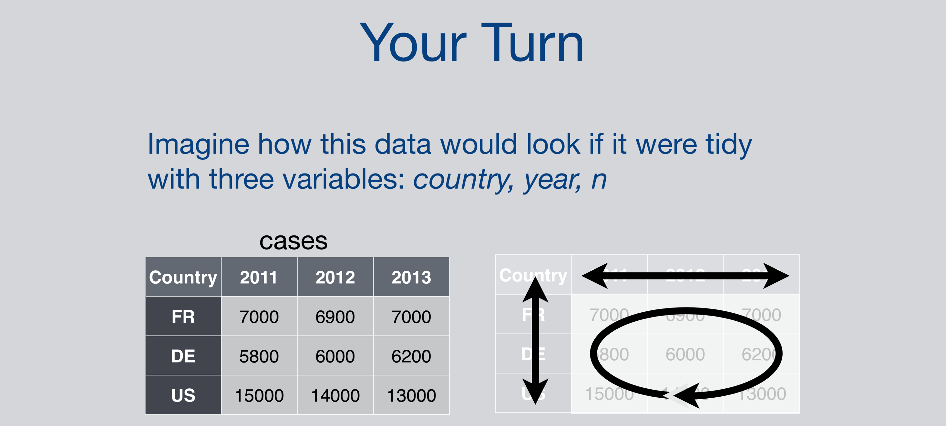
Data Wrangling: tidy data

Slide 19
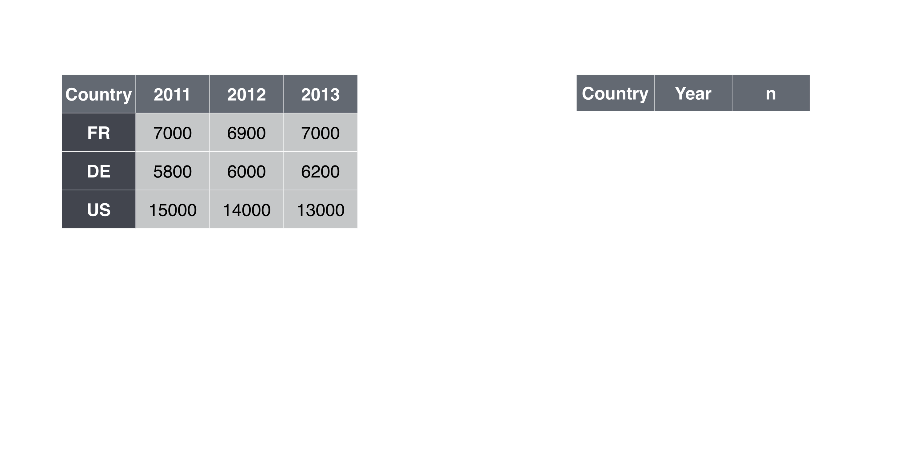
Data Wrangling: tidy data

Slide 20
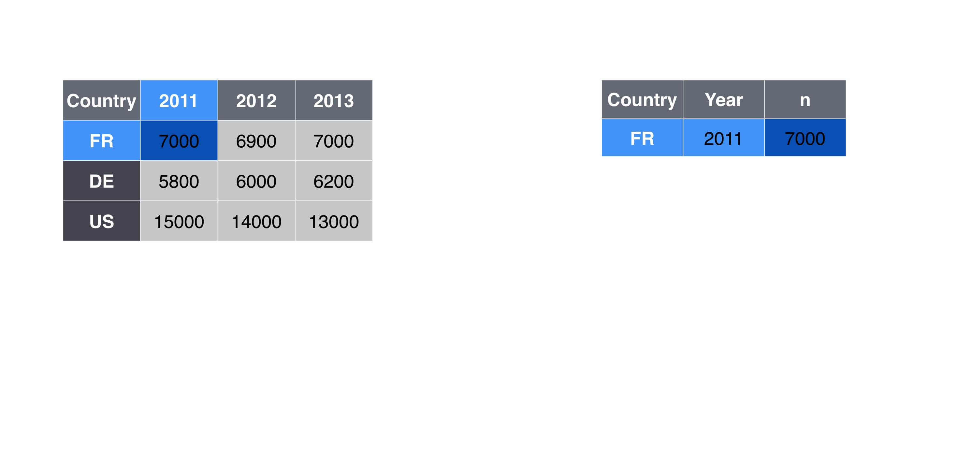
Data Wrangling: tidy data

Slide 21
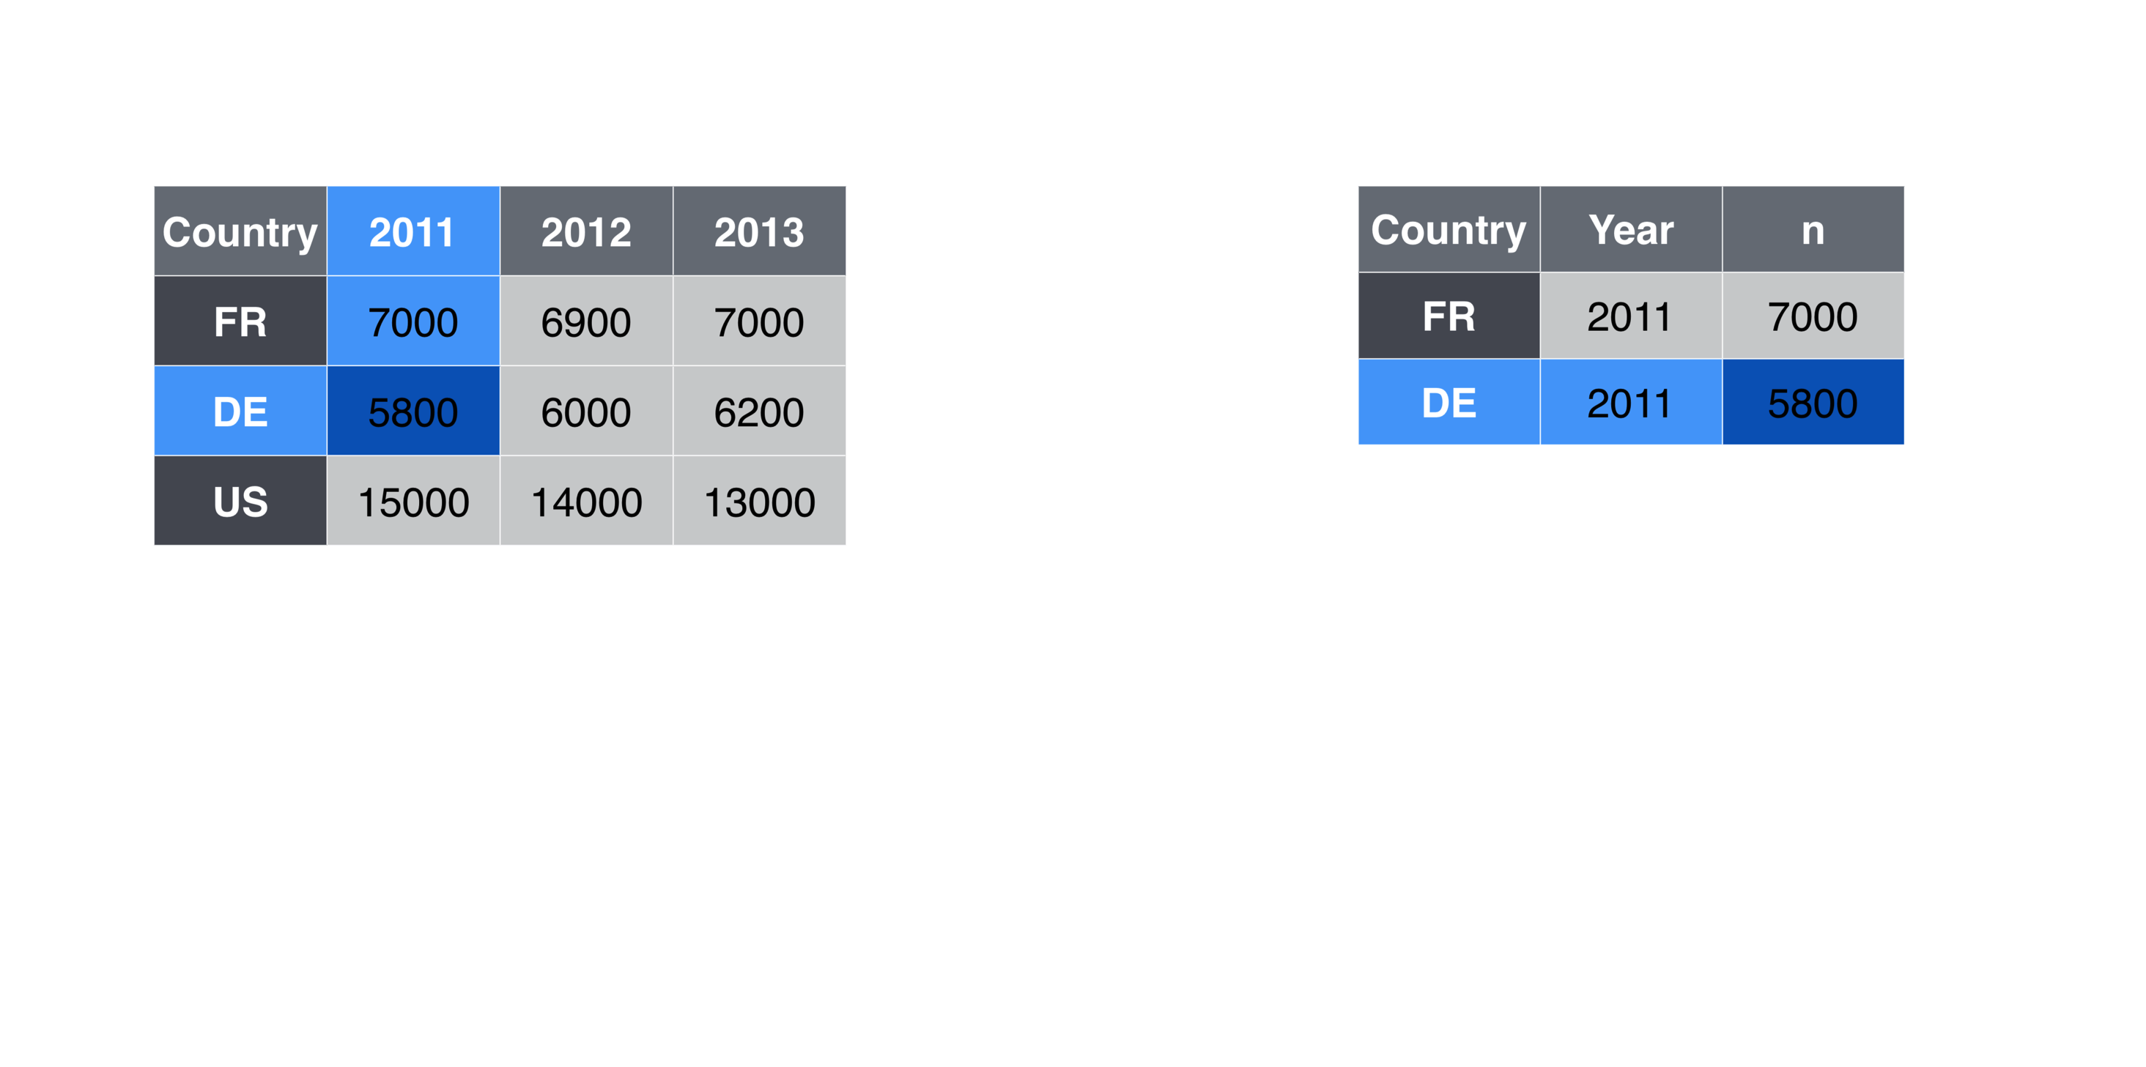
Data Wrangling: tidy data

Slide 22
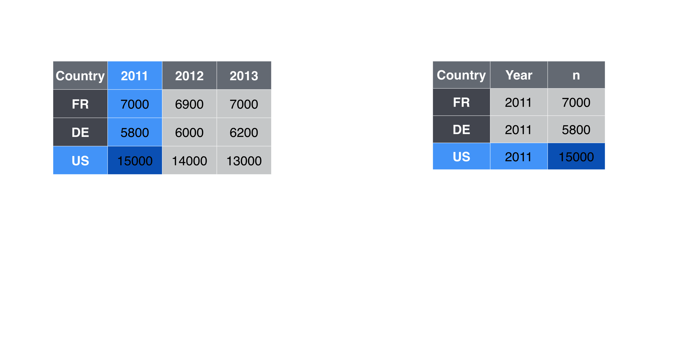
Data Wrangling: tidy data

Slide 23
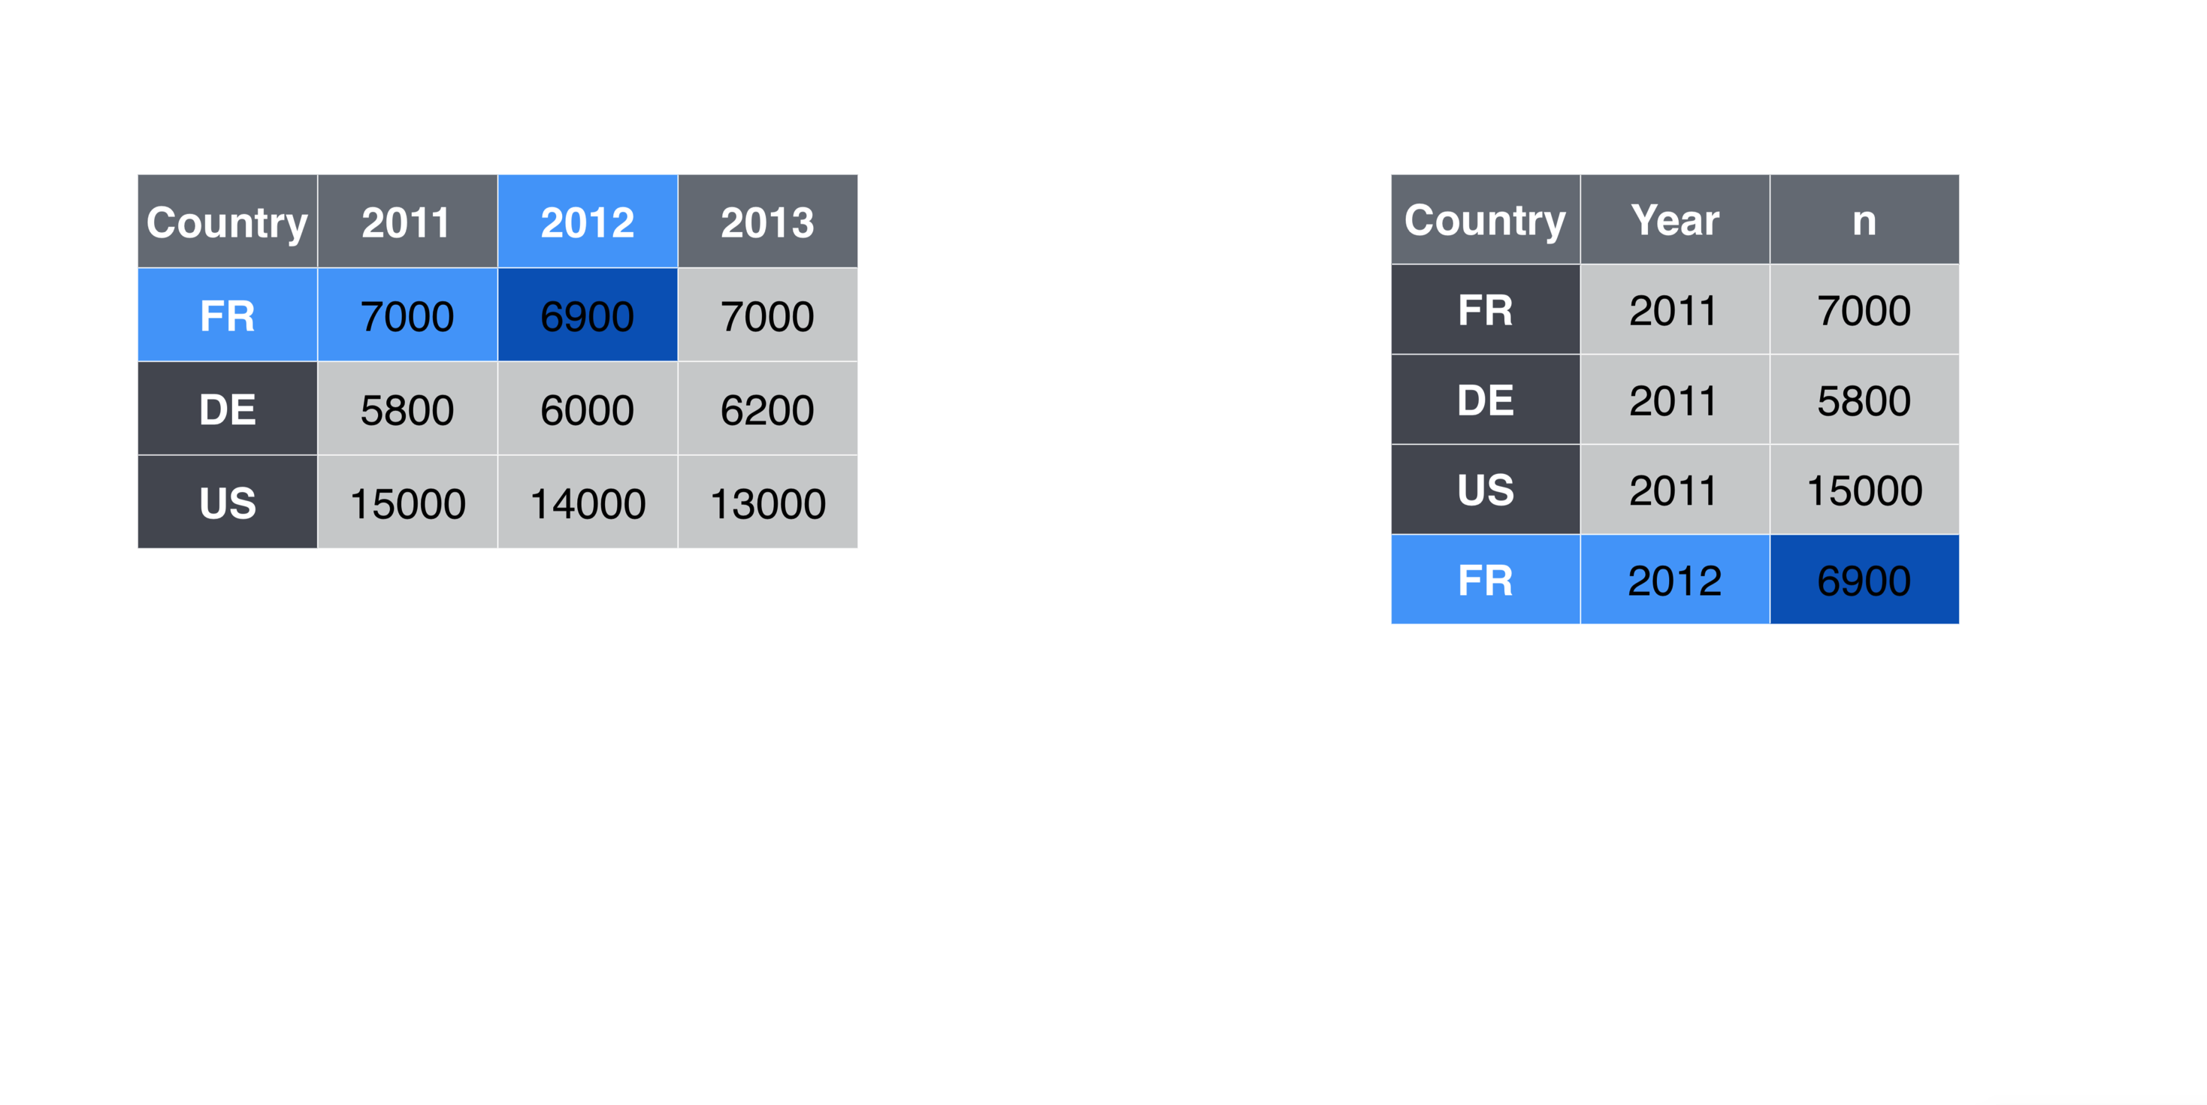
Data Wrangling: tidy data

Slide 24
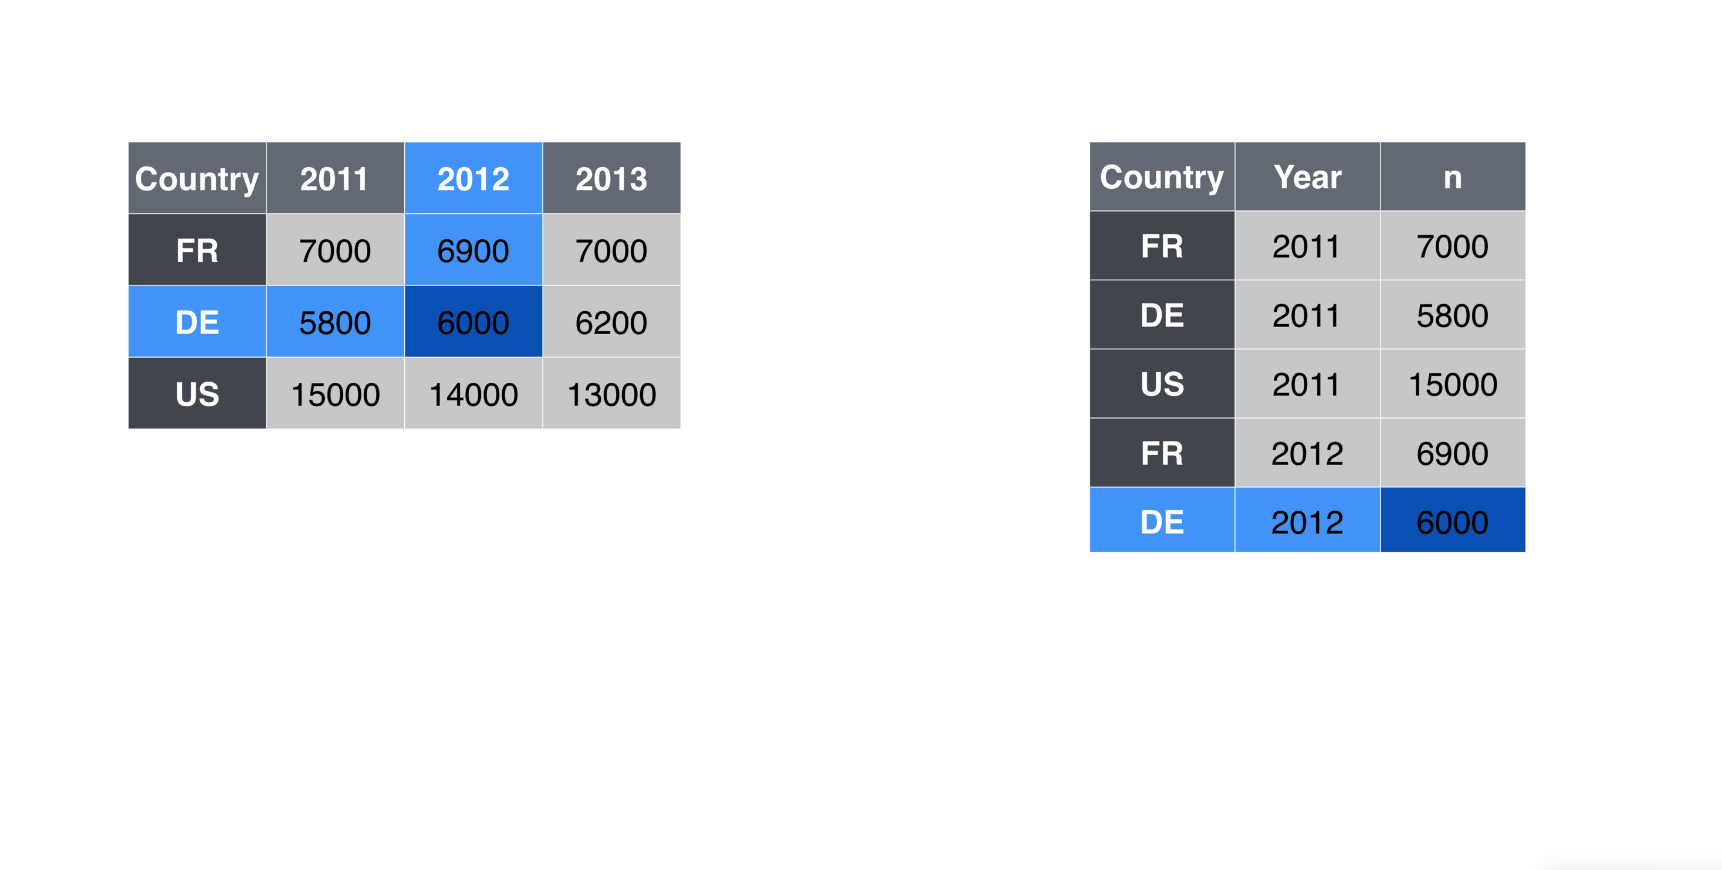
Data Wrangling: tidy data

Slide 25
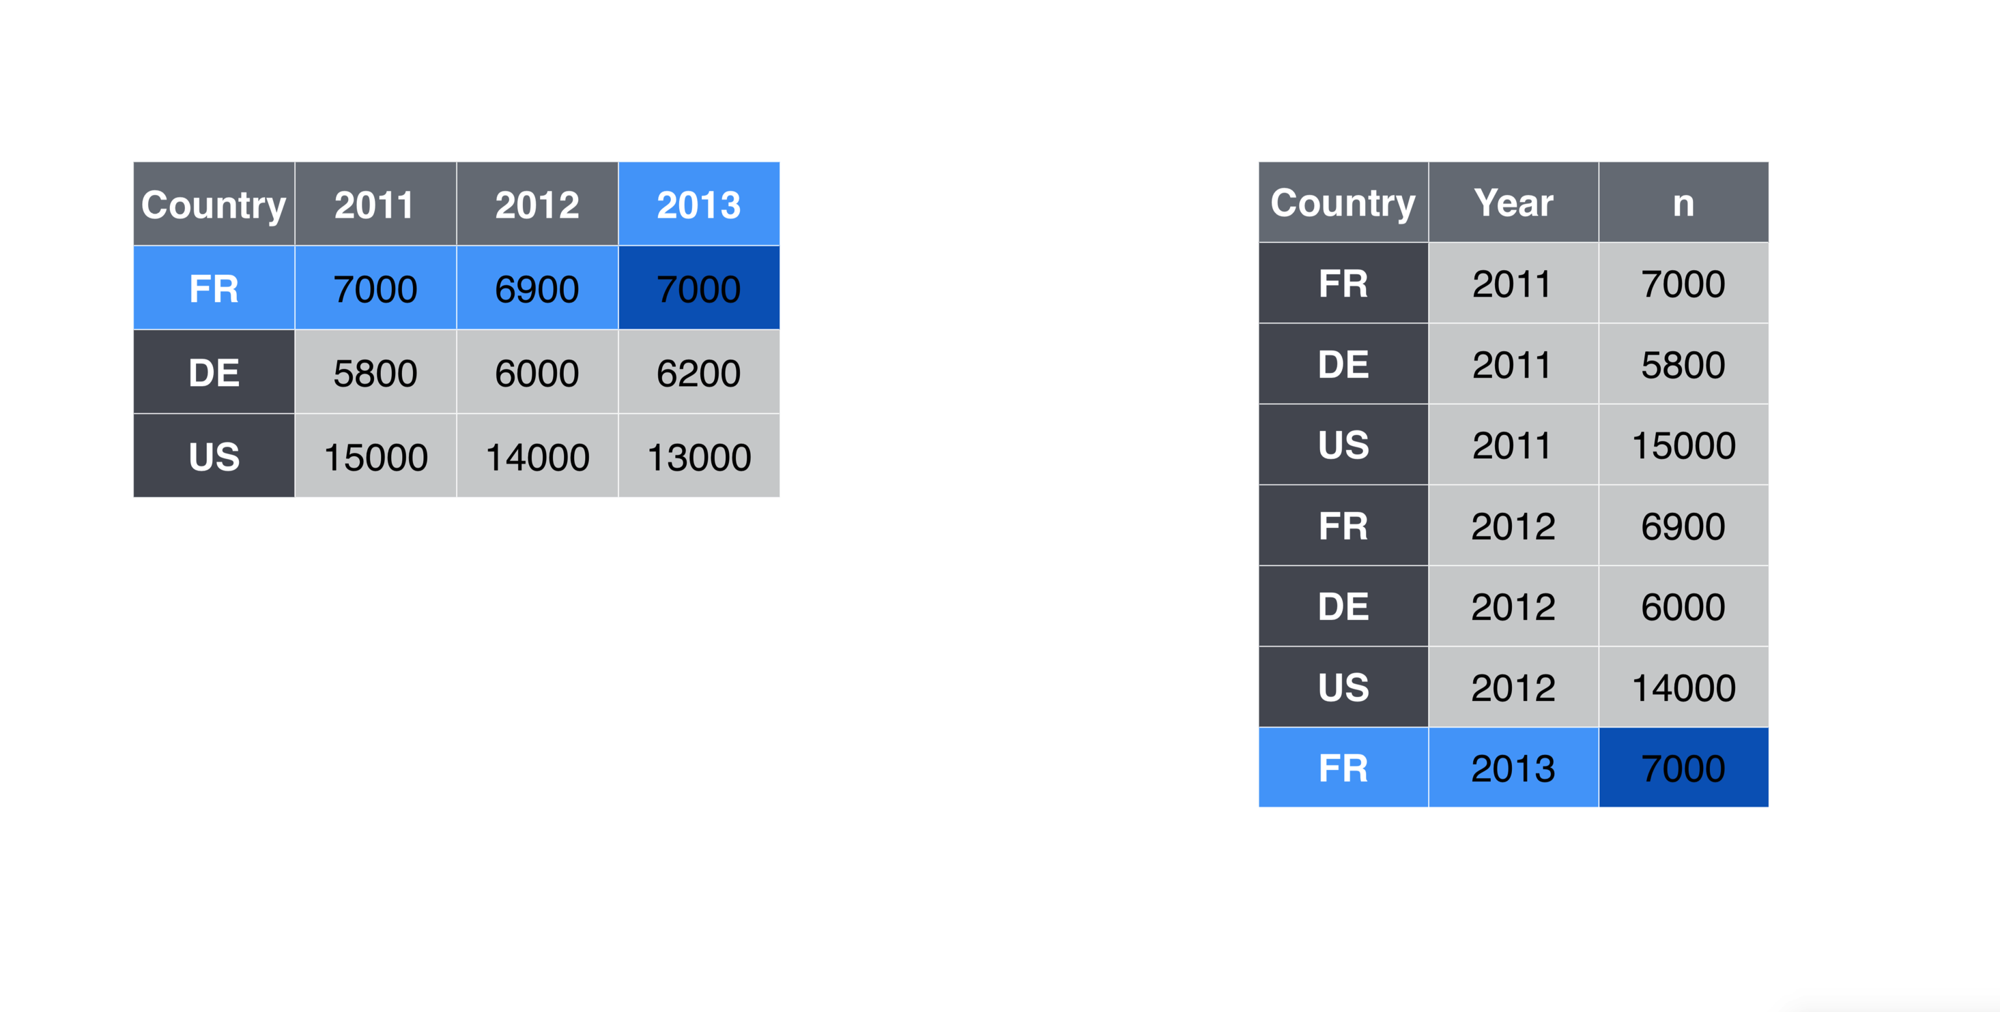
Data Wrangling: tidy data

Slide 26
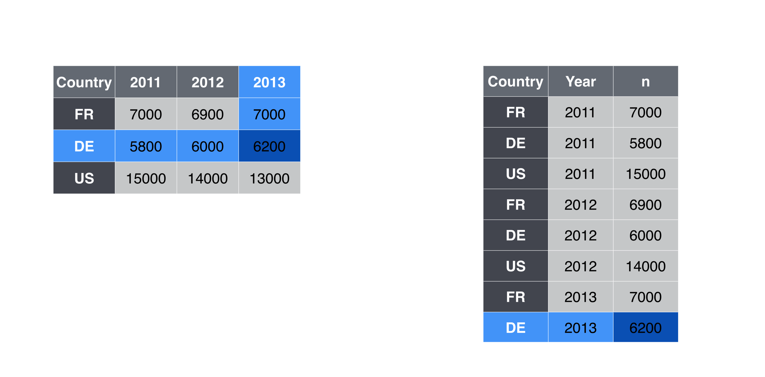
Data Wrangling: tidy data

Slide 27
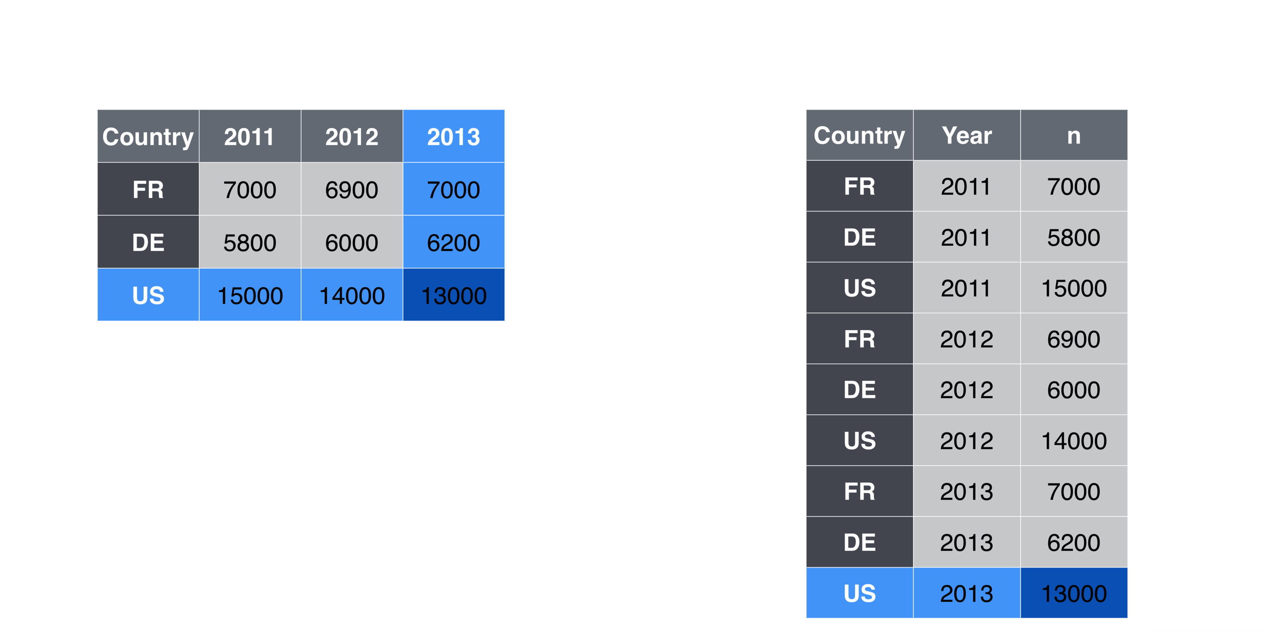
Data Wrangling: tidy data

Slide 28
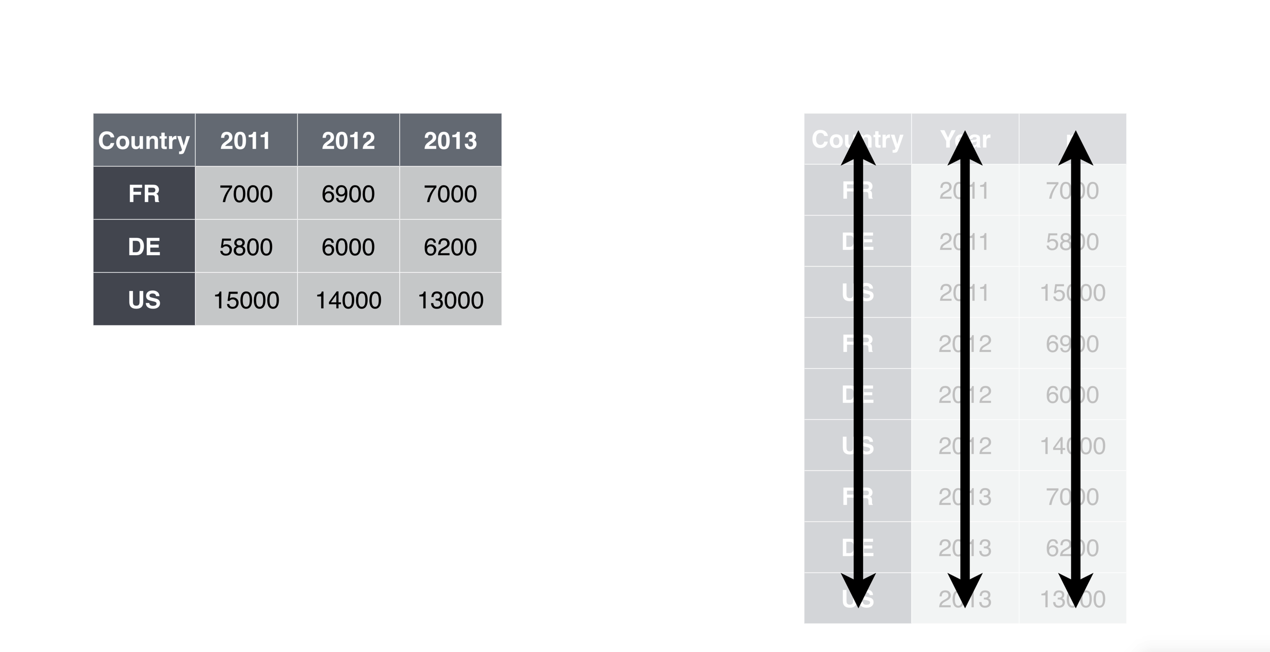
Data Wrangling: tidy data

Slide 29
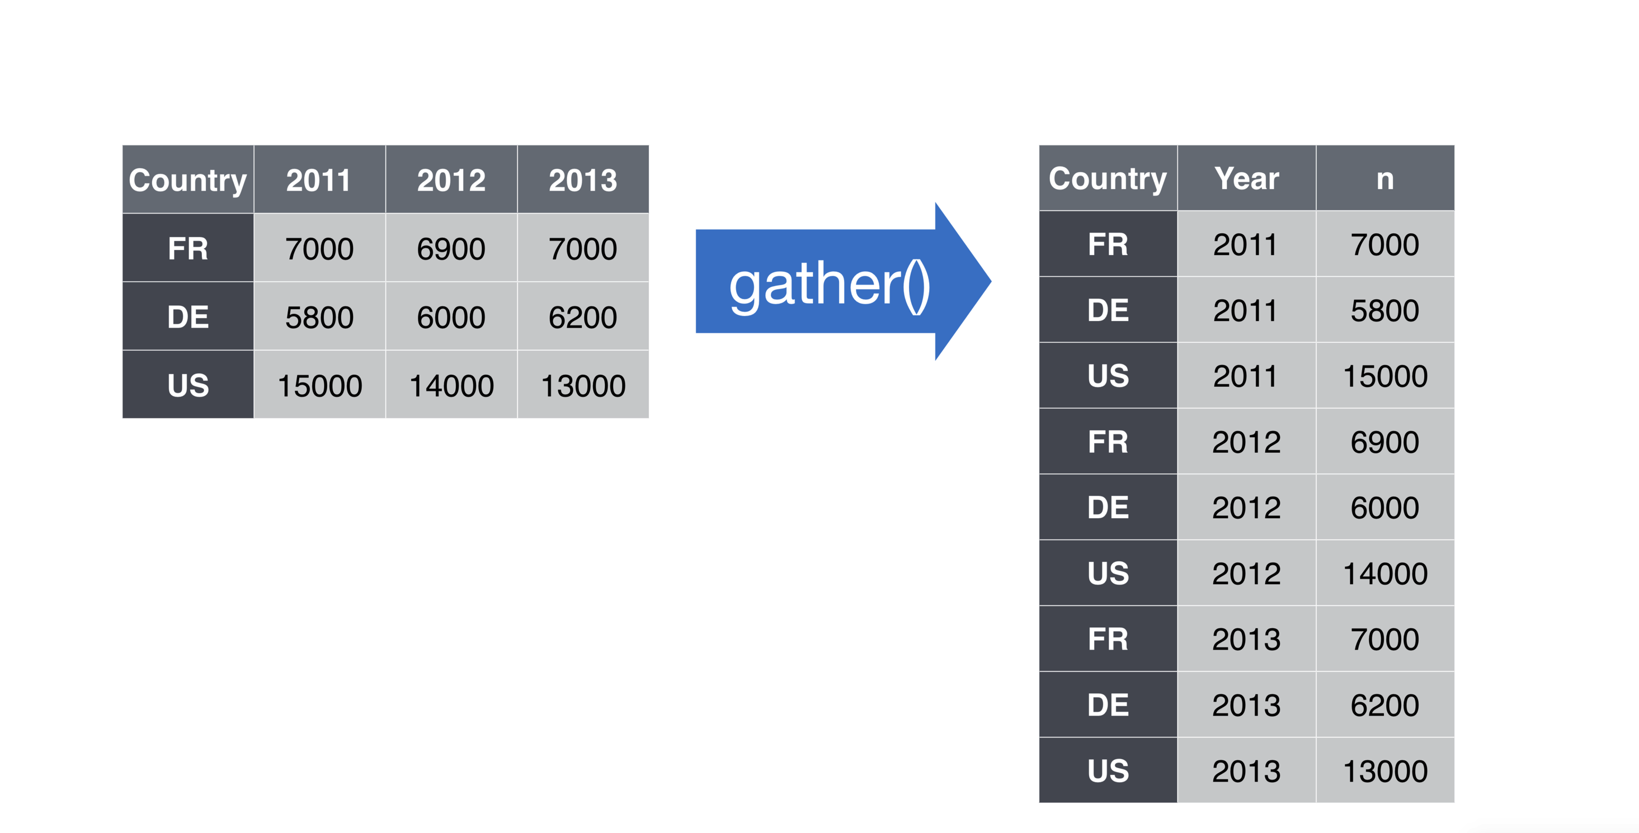
Data Wrangling: using gather() to get tidy data

Slide 30
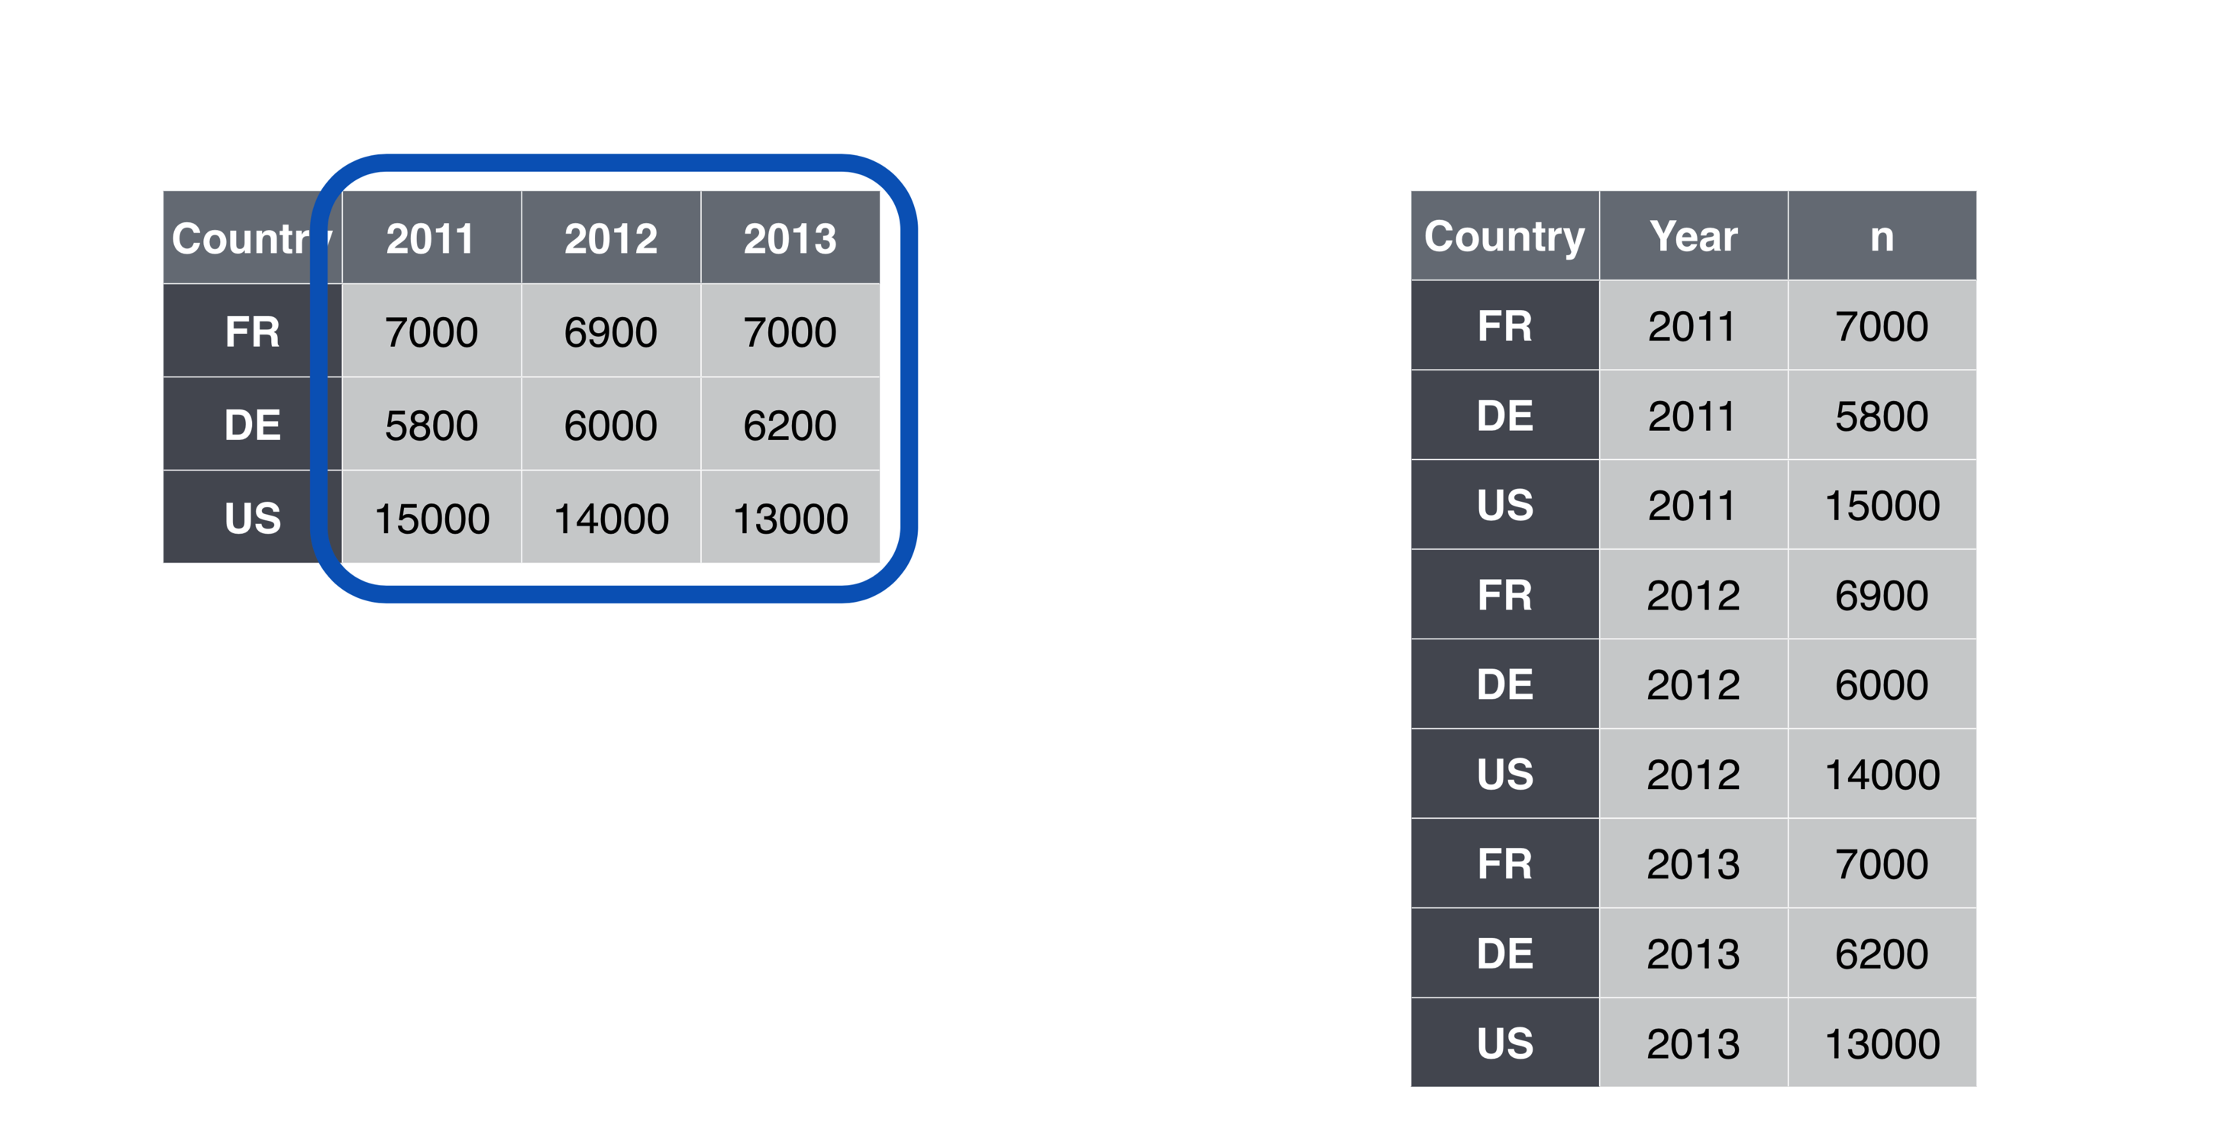
Data Wrangling: using gather() to get tidy data

Slide 31
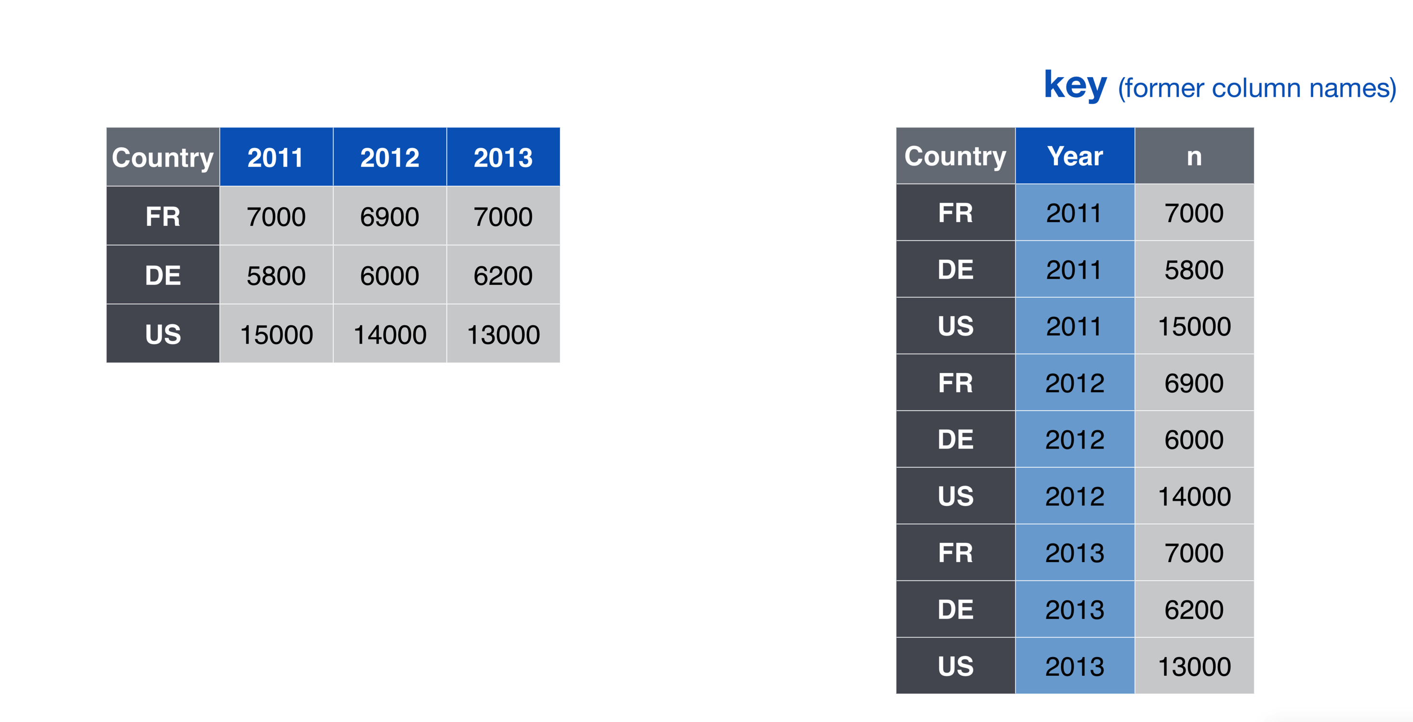
Data Wrangling: using gather() to get tidy data

Slide 32
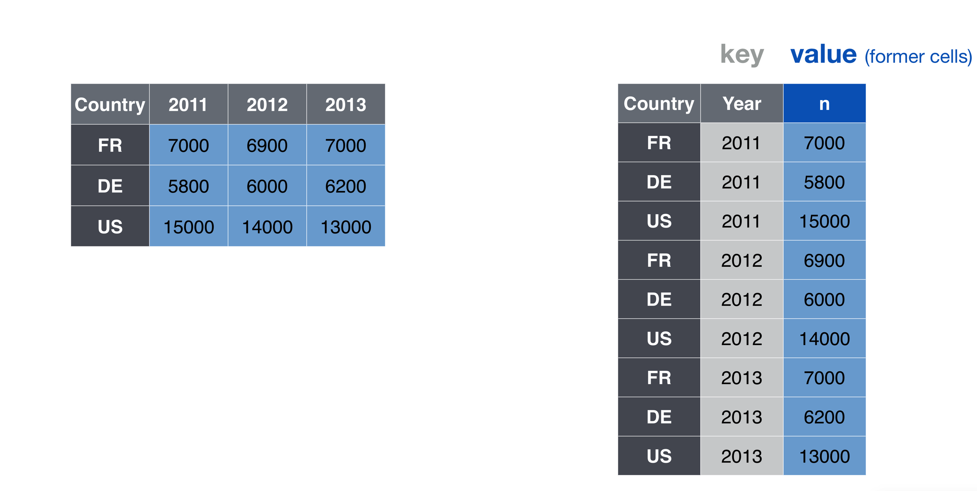
Data Wrangling: using gather() to get tidy data

Slide 33
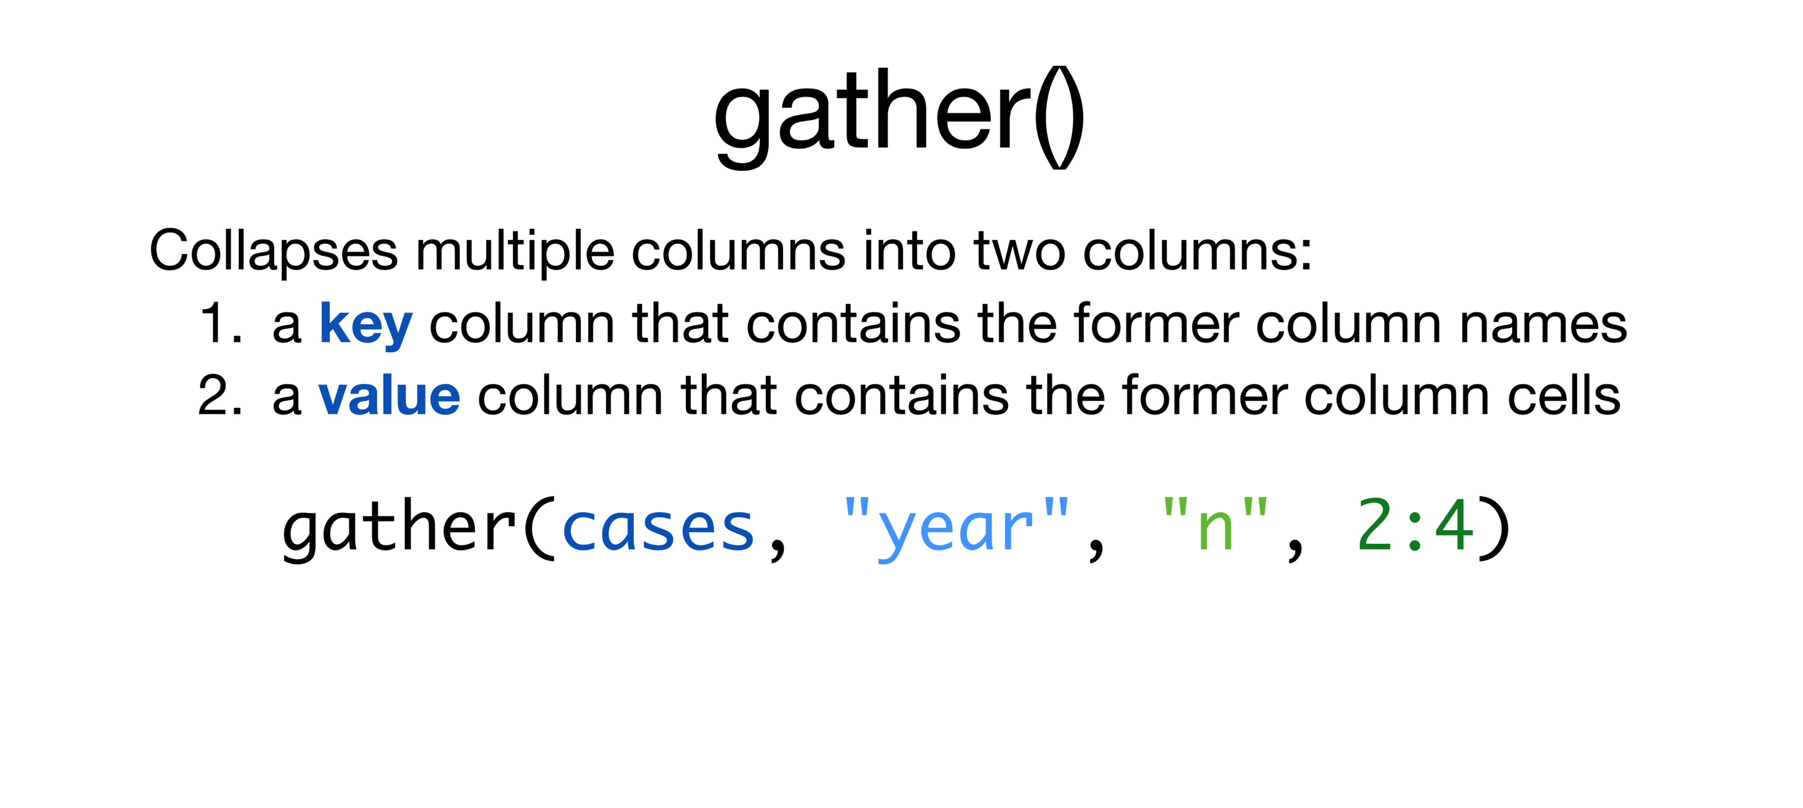
Data Wrangling: using gather() to get tidy data

Slide 34
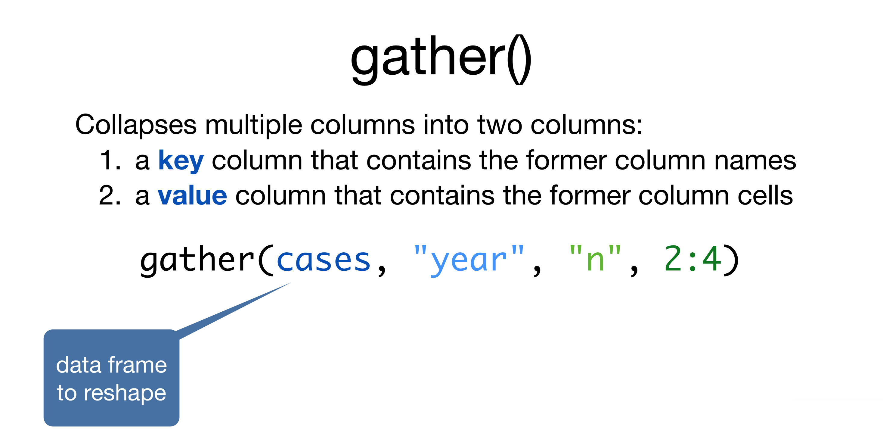
Data Wrangling: using gather() to get tidy data

Slide 35
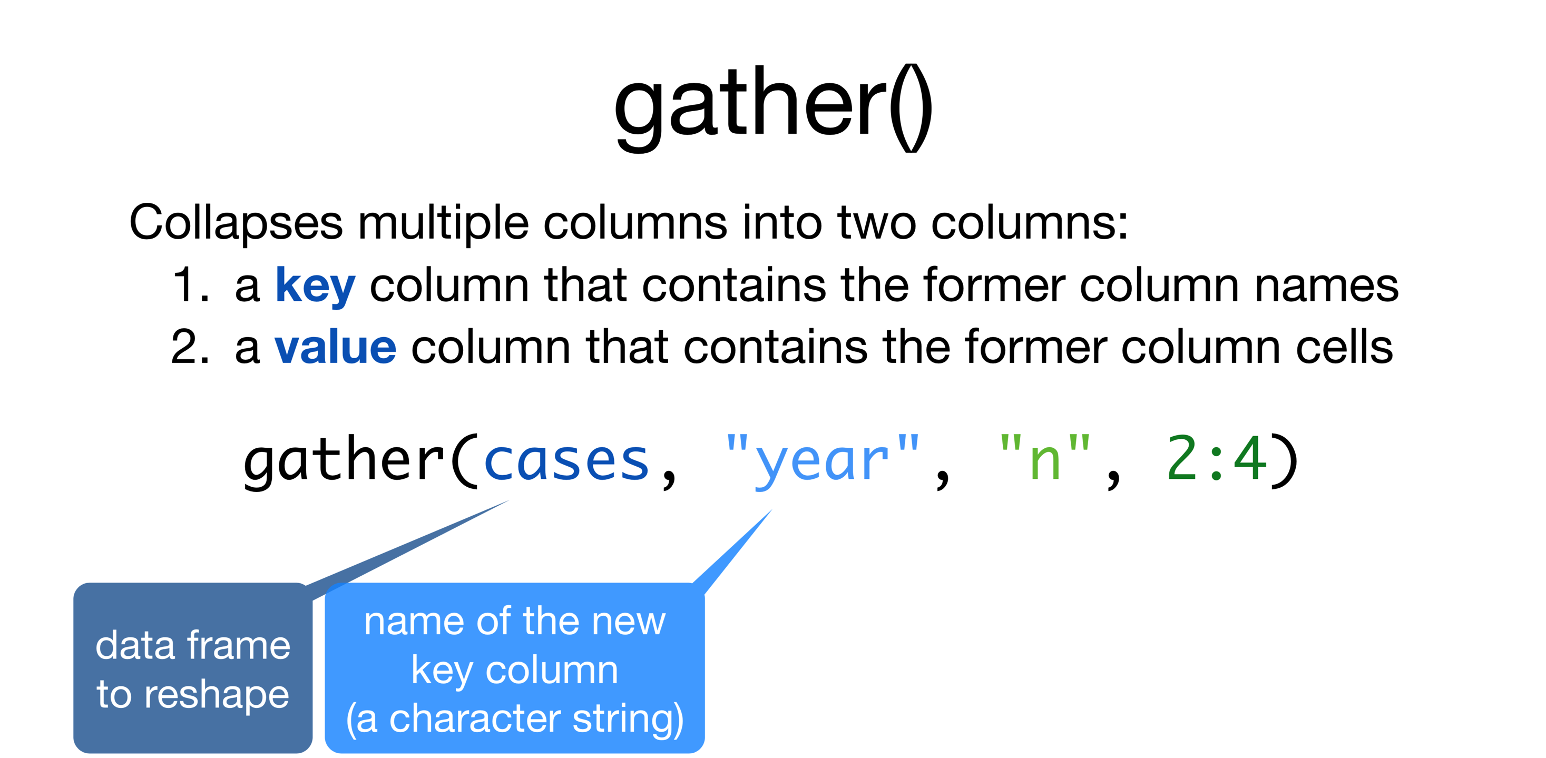
Data Wrangling: using gather() to get tidy data

Slide 36
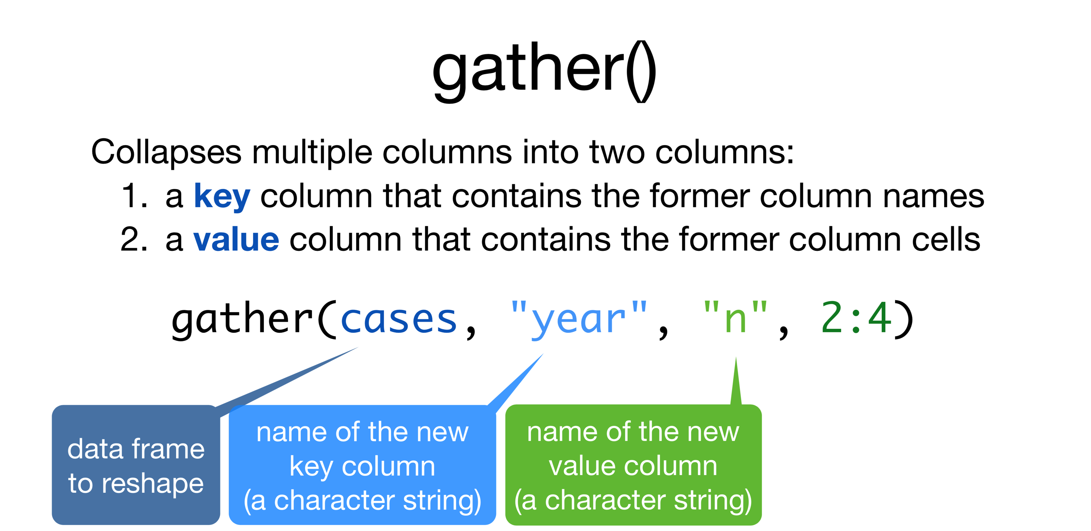
Data Wrangling: using gather() to get tidy data

Slide 37
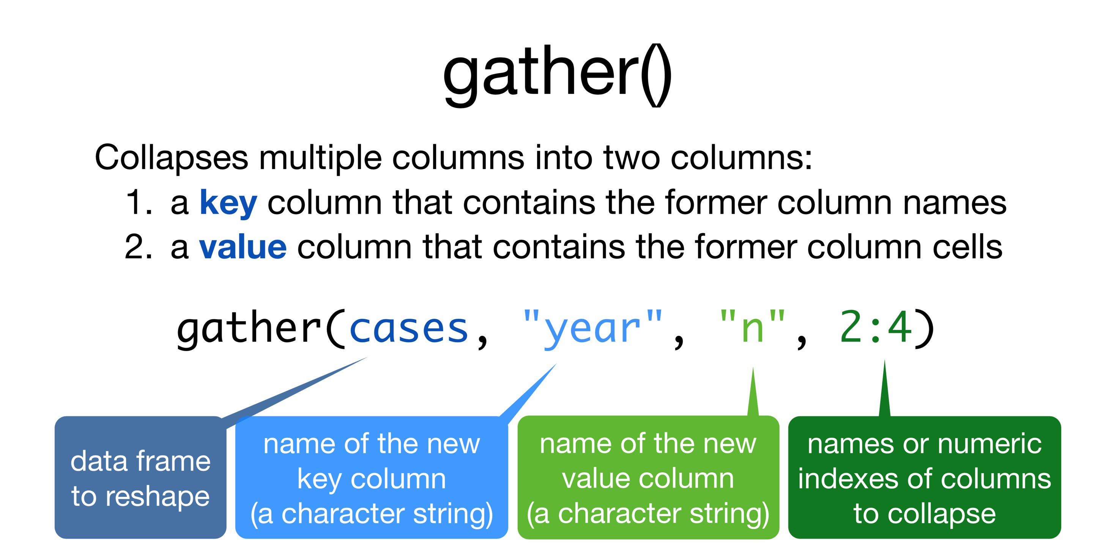
Data Wrangling: using gather() to get tidy data

Slide 38
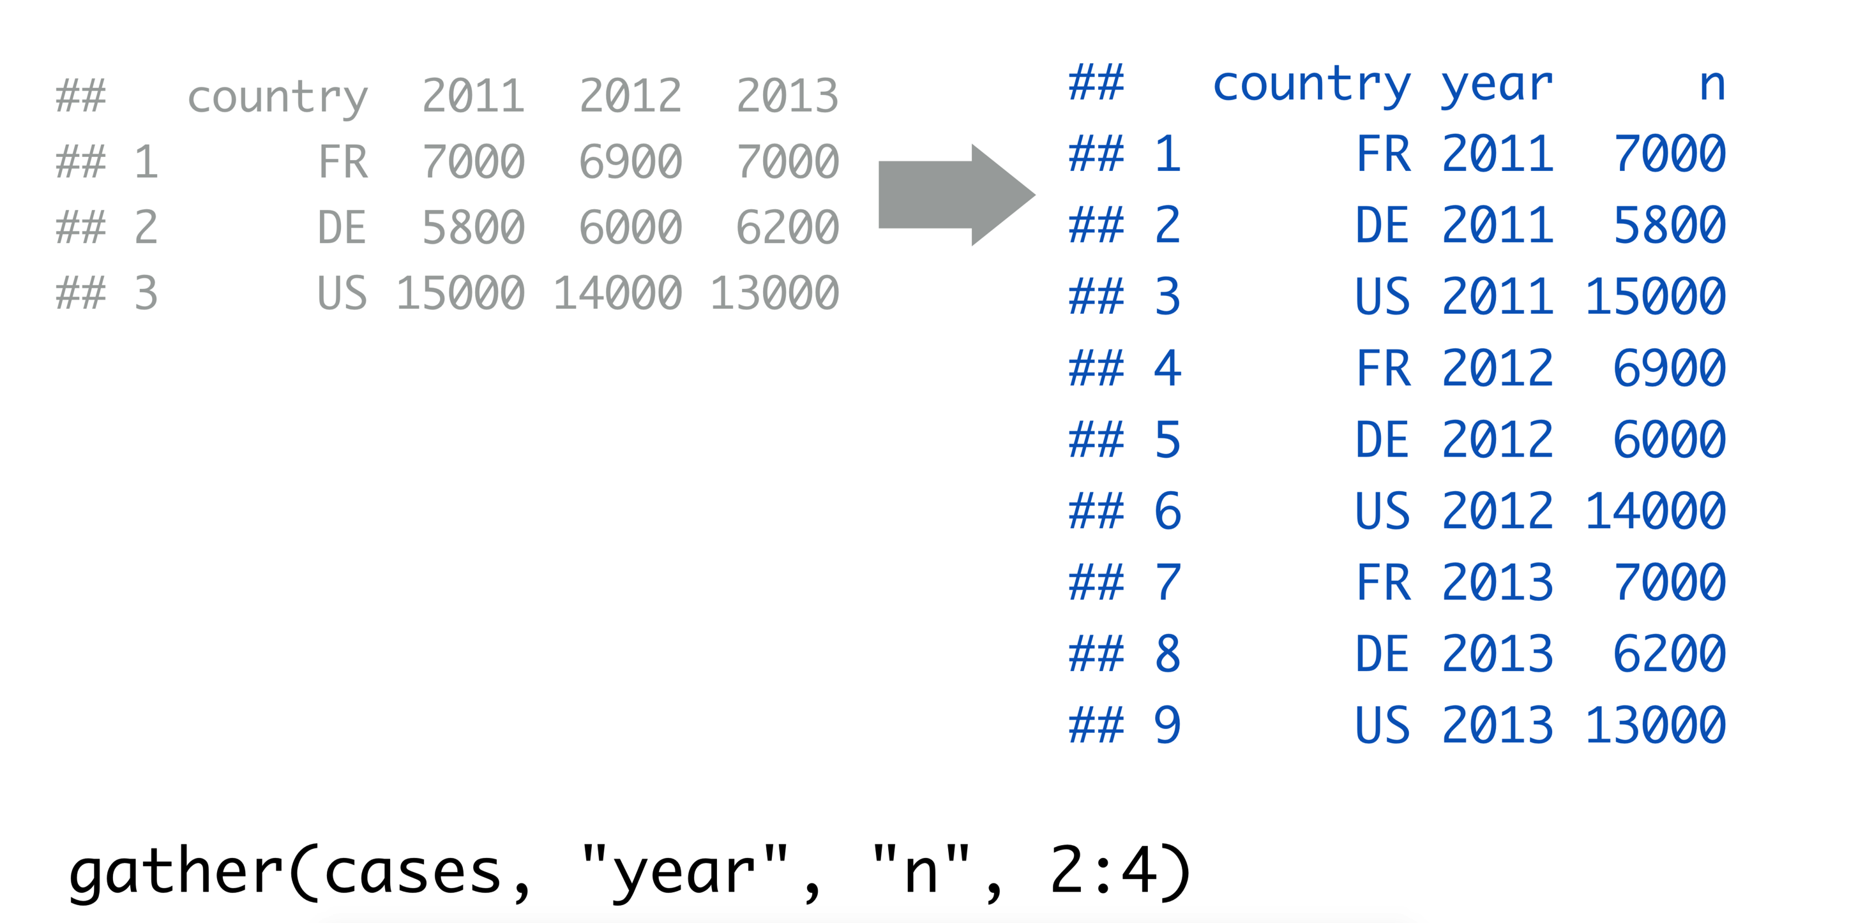
Data Wrangling: using gather() to get tidy data

Slide 39
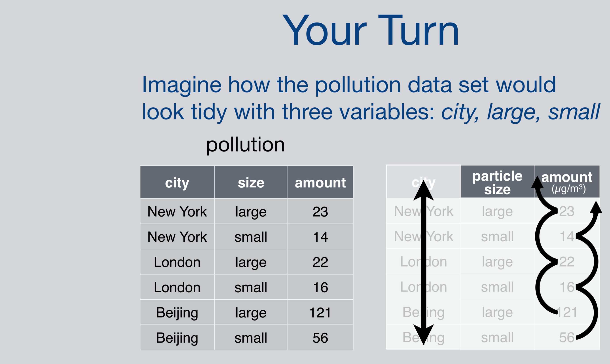
Data Wrangling: tidy data with pollution data set

Slide 40
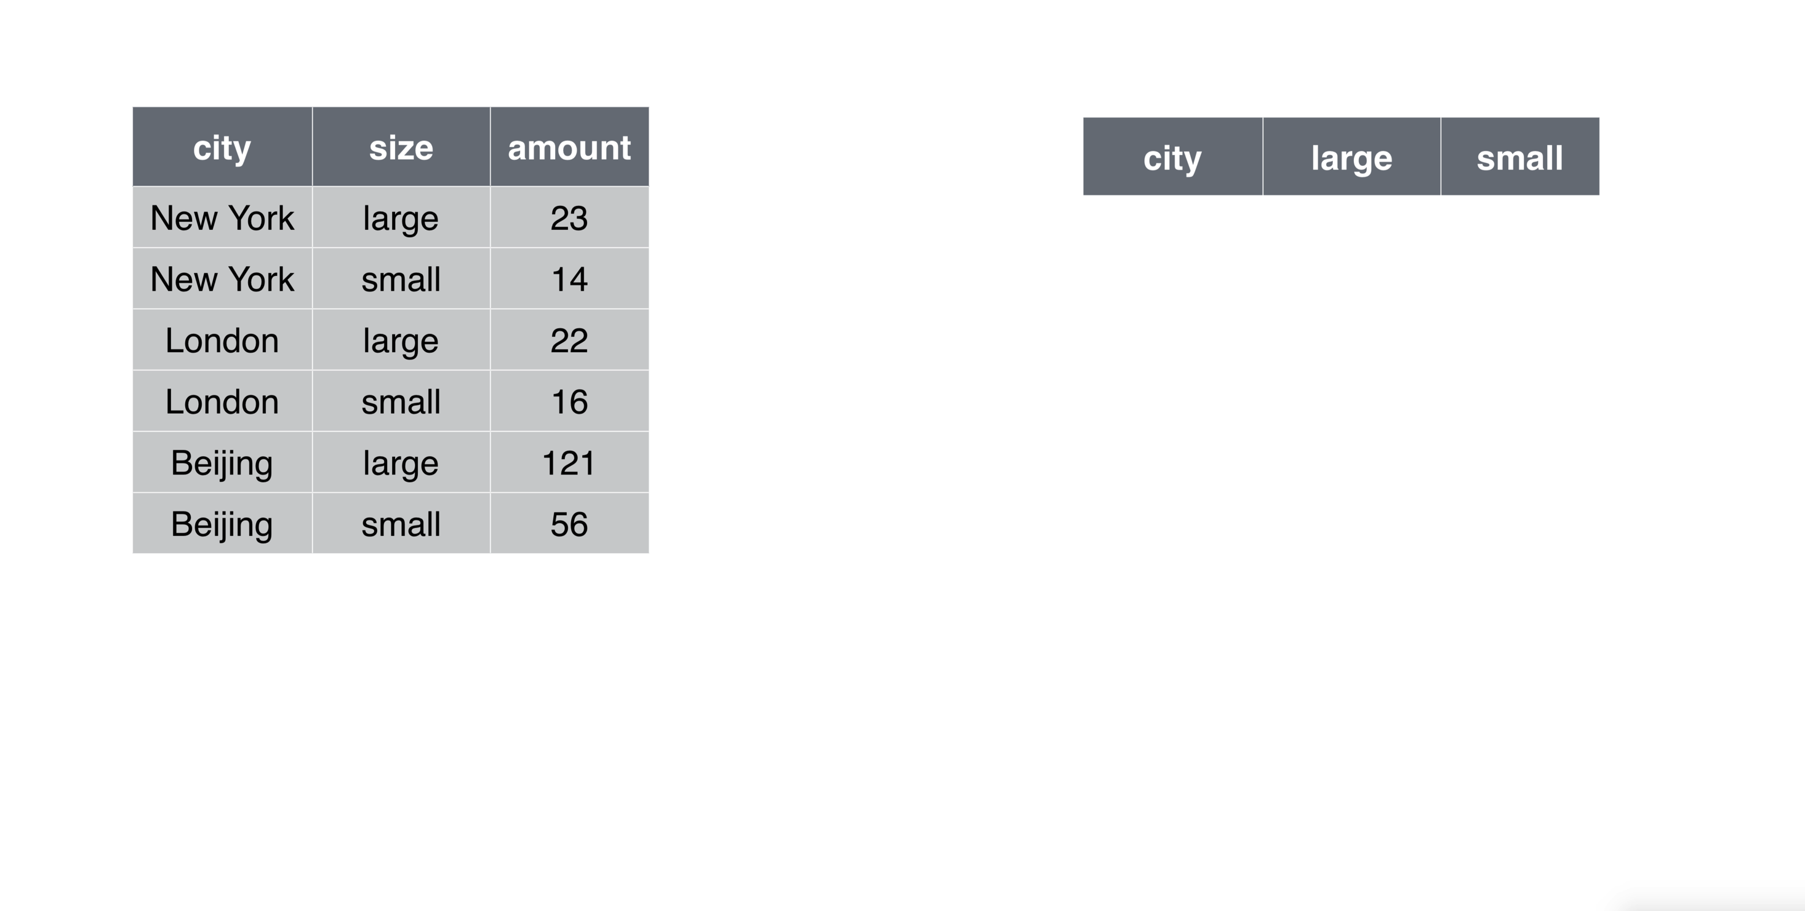
Data Wrangling: tidy data with pollution data set

Slide 41
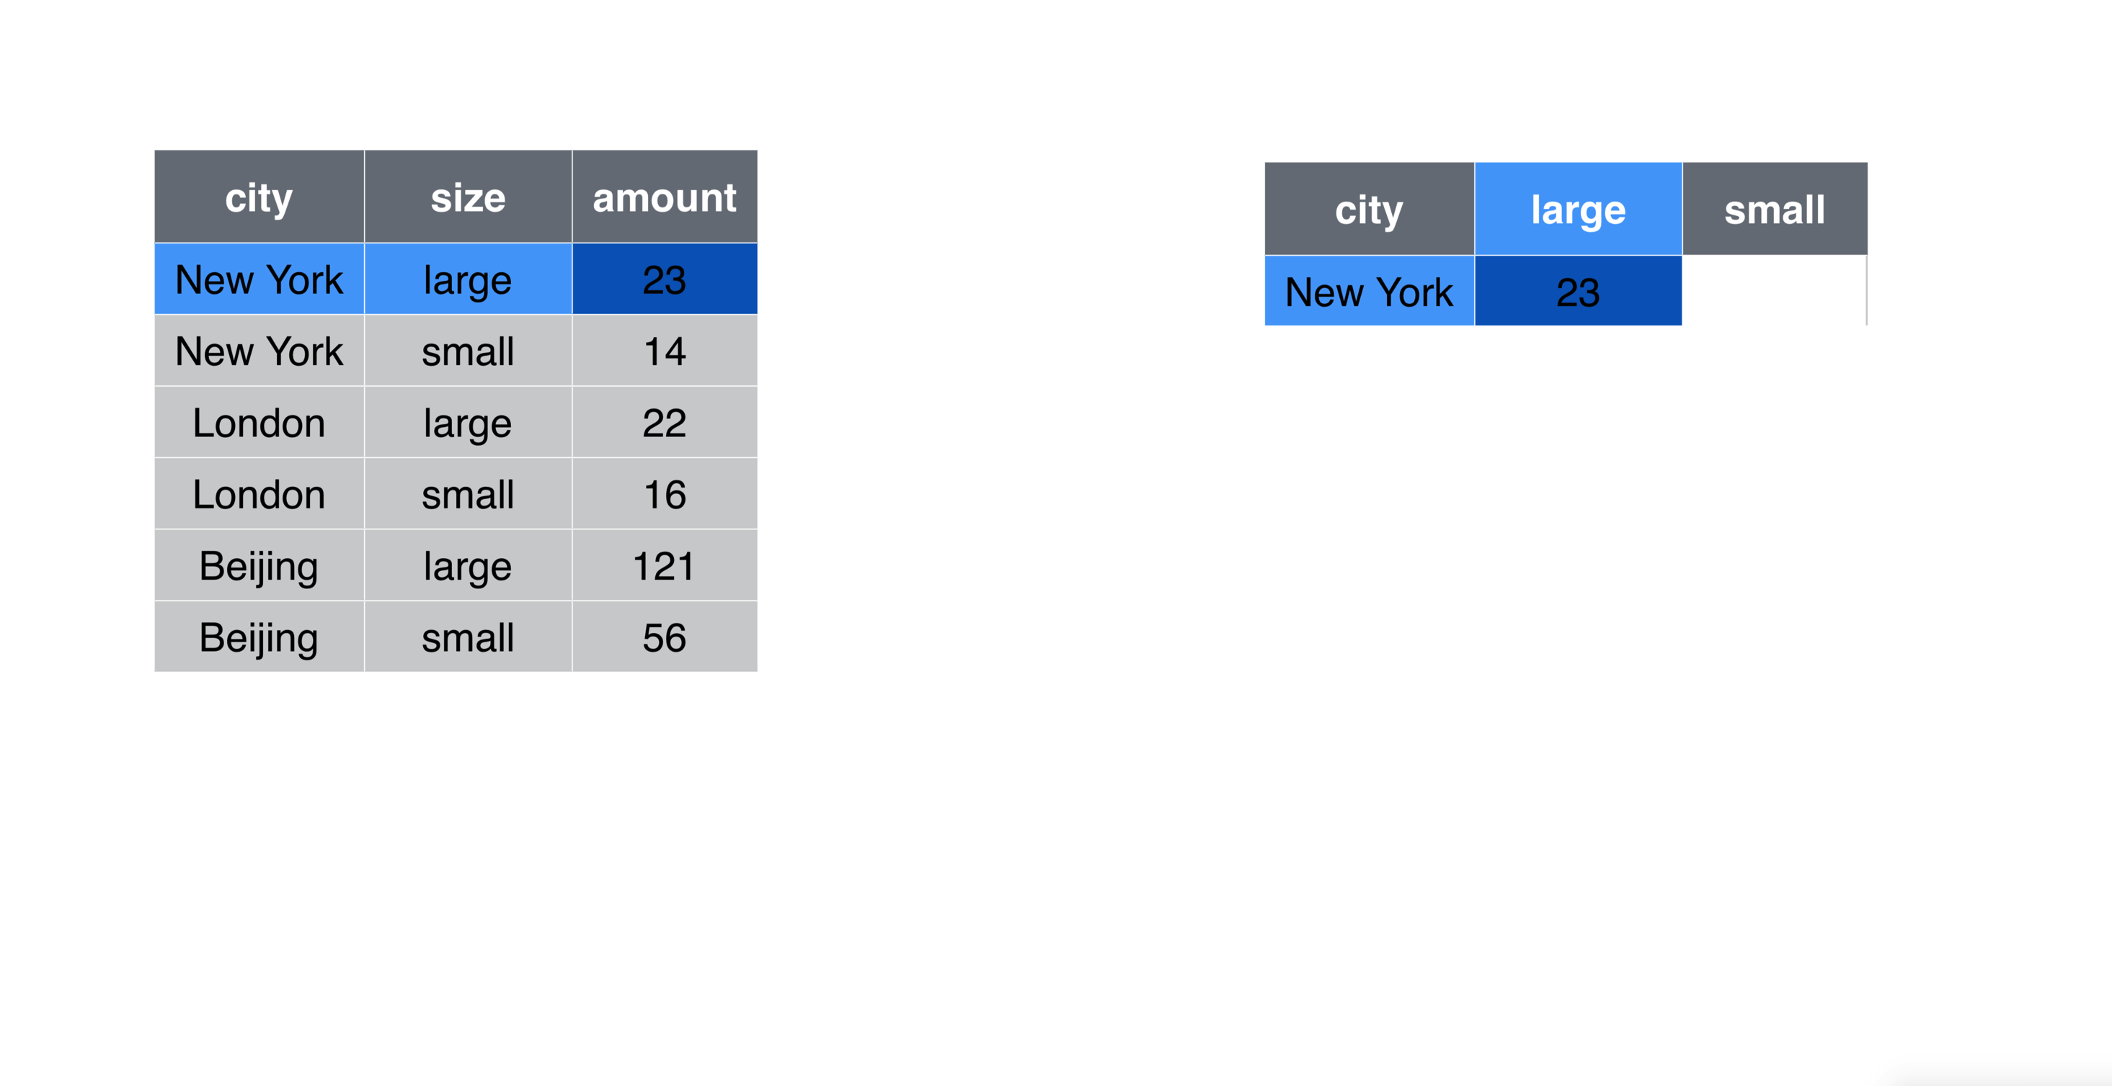
Data Wrangling: tidy data with pollution data set

Slide 42
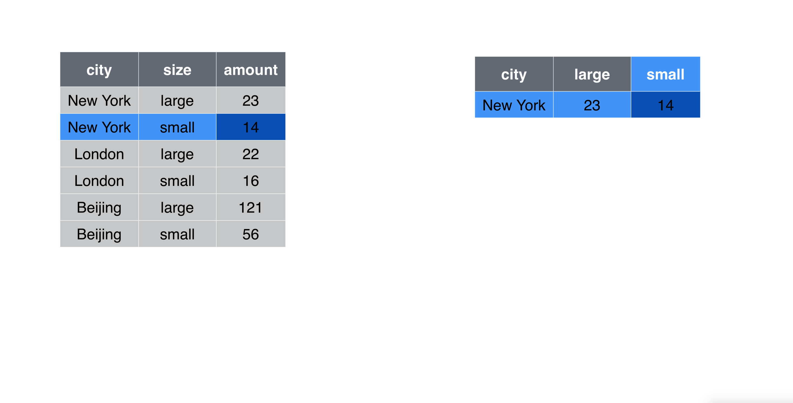
Data Wrangling: tidy data with pollution data set

Slide 43
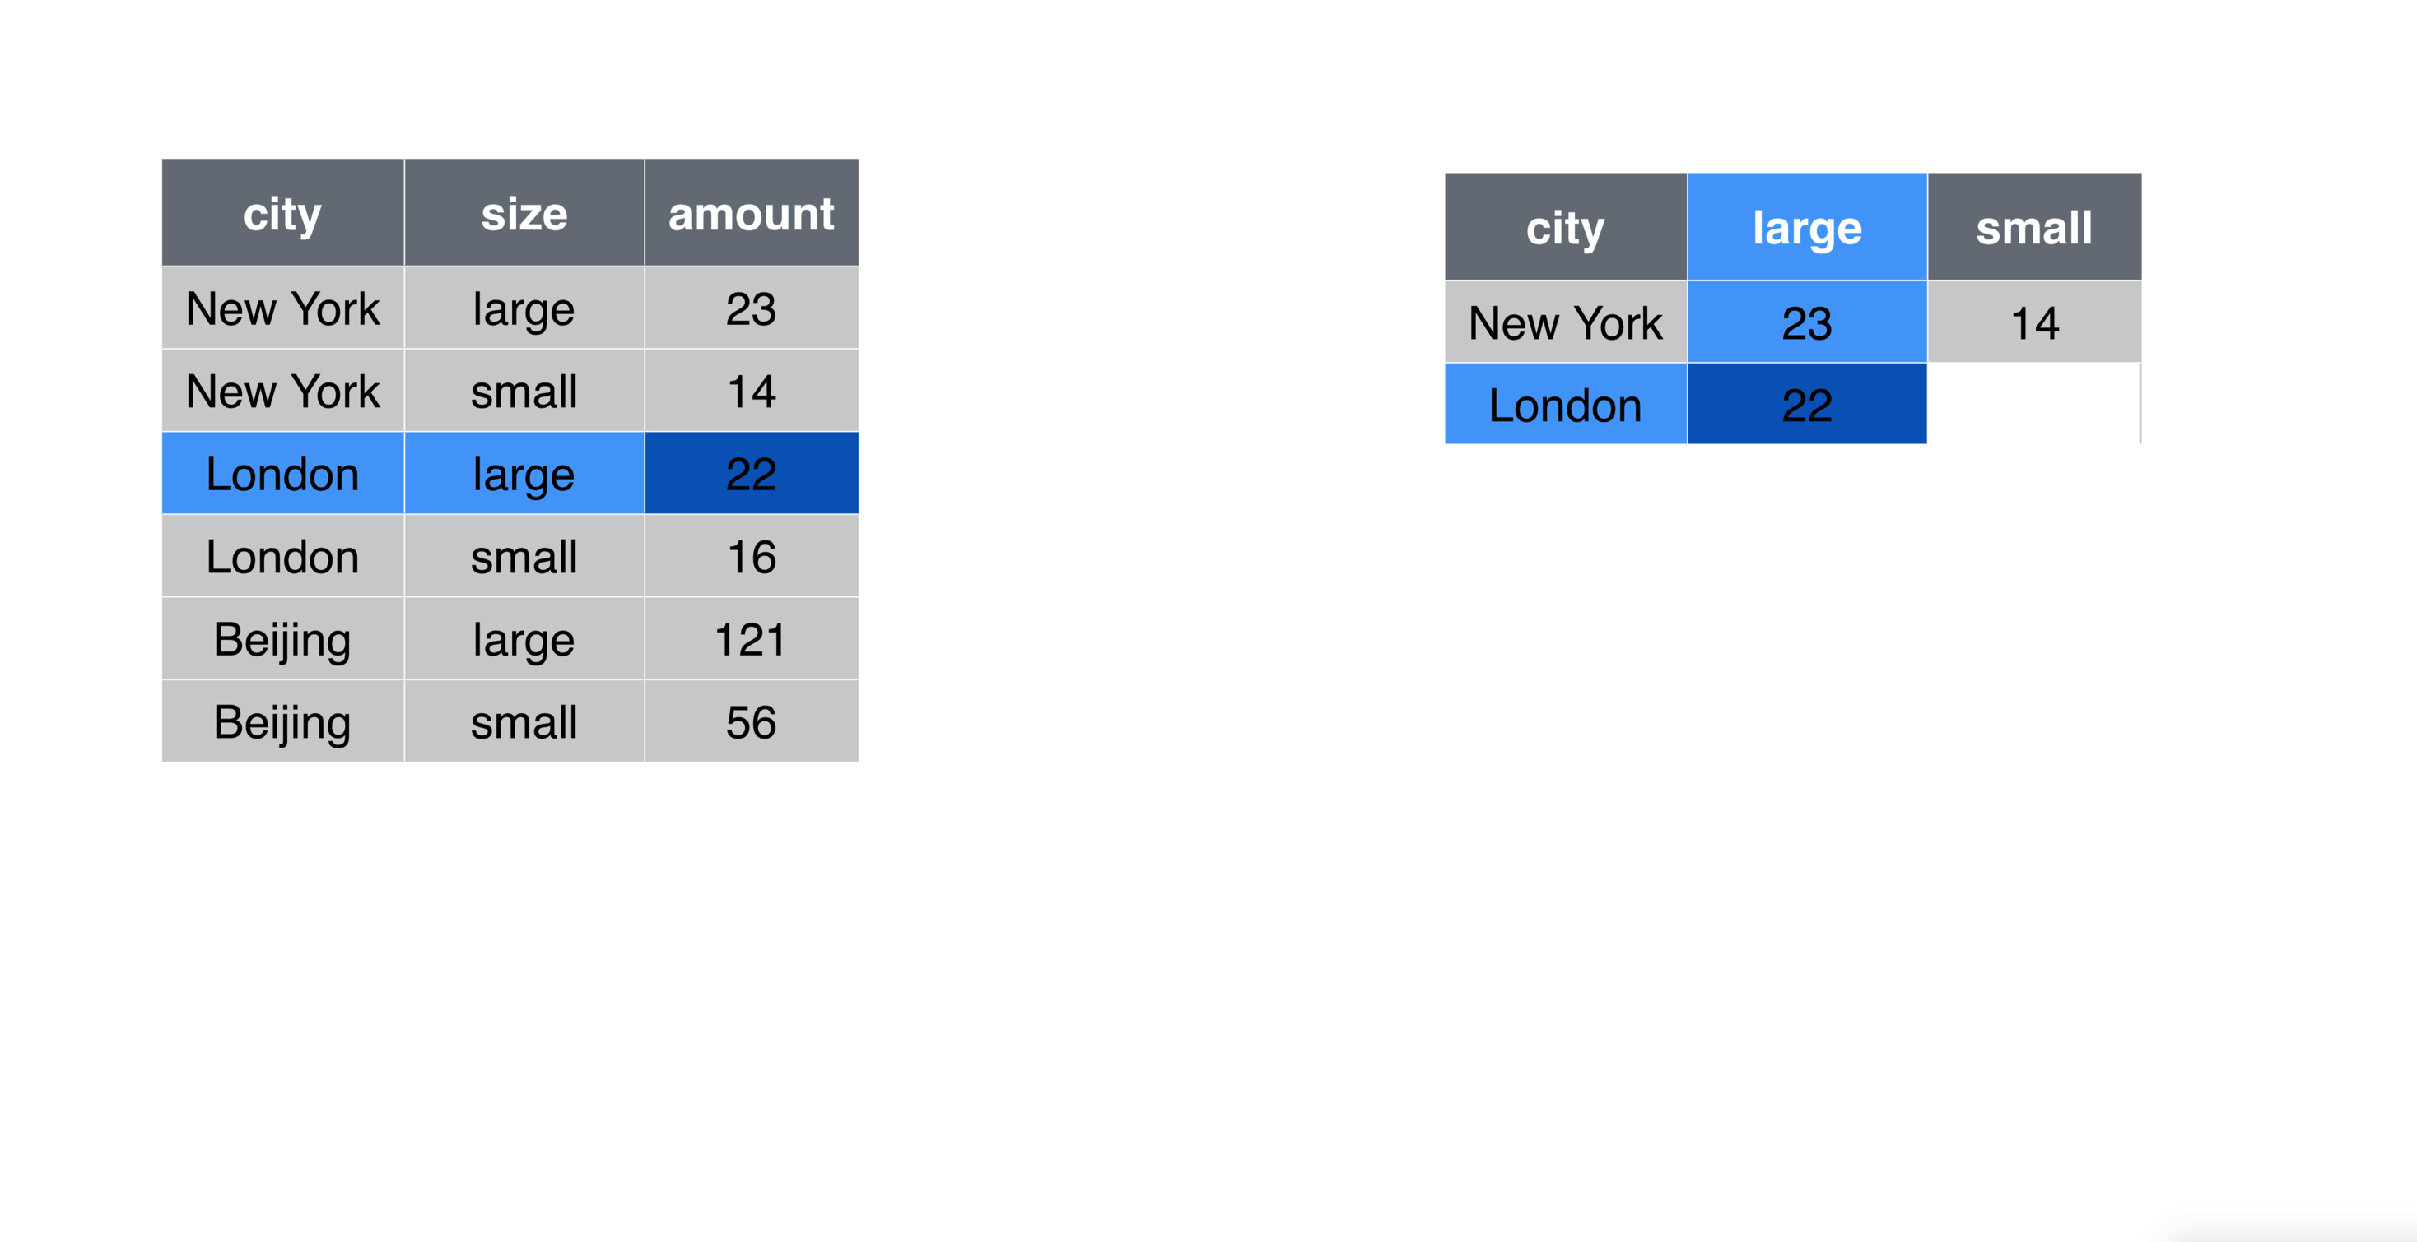
Data Wrangling: tidy data with pollution data set

Slide 44
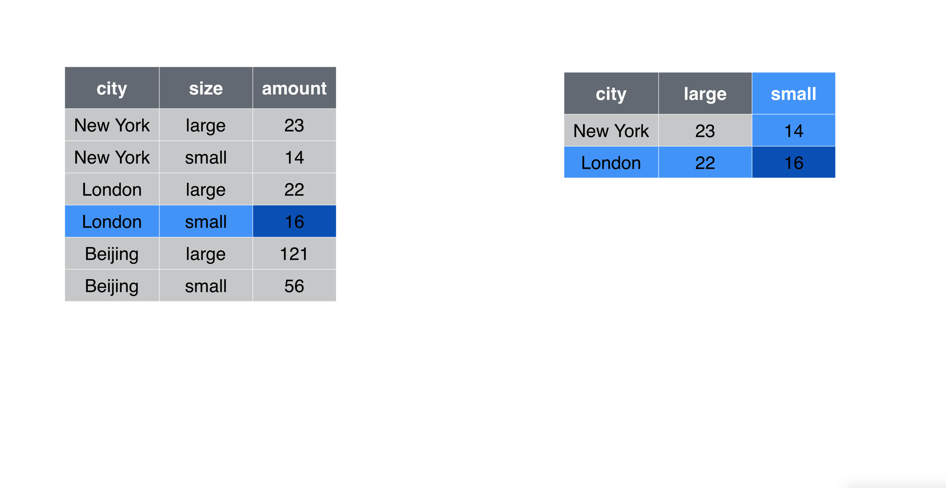
Data Wrangling: tidy data with pollution data set

Slide 45
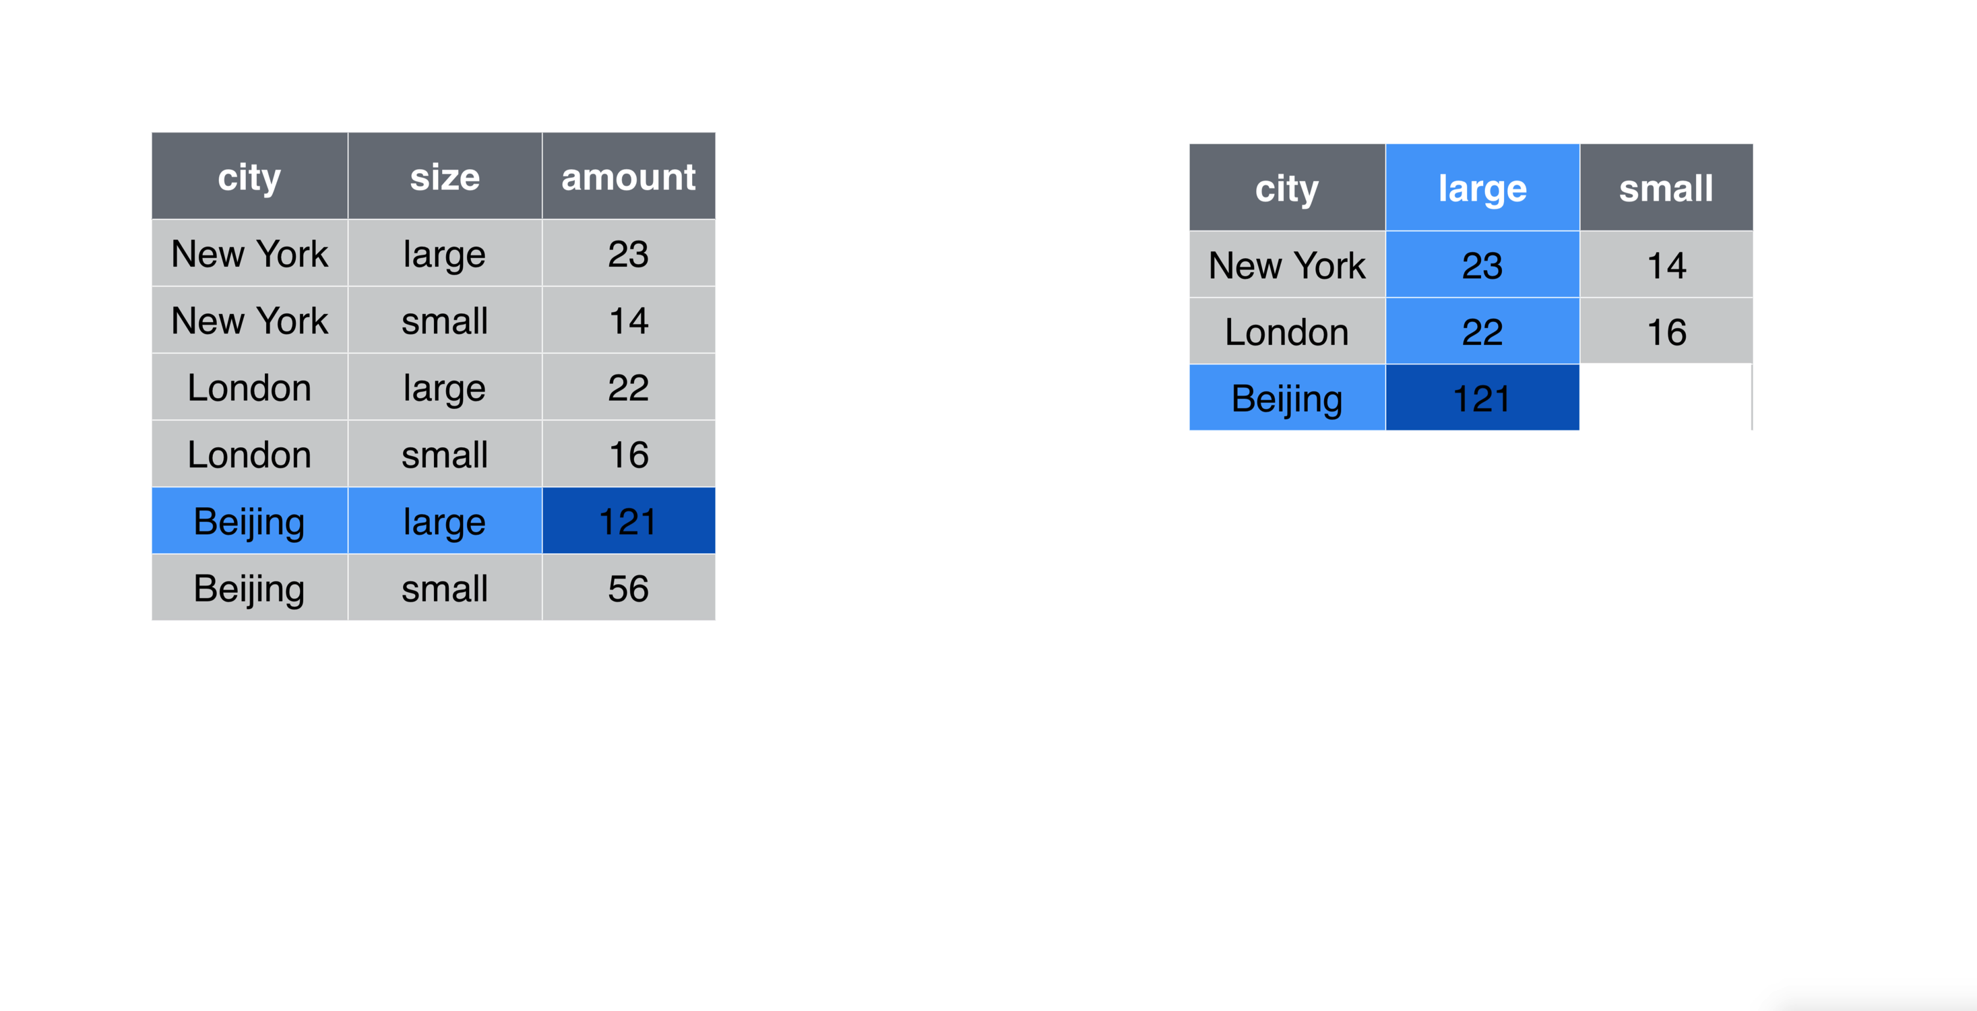
Data Wrangling: tidy data with pollution data set

Slide 46
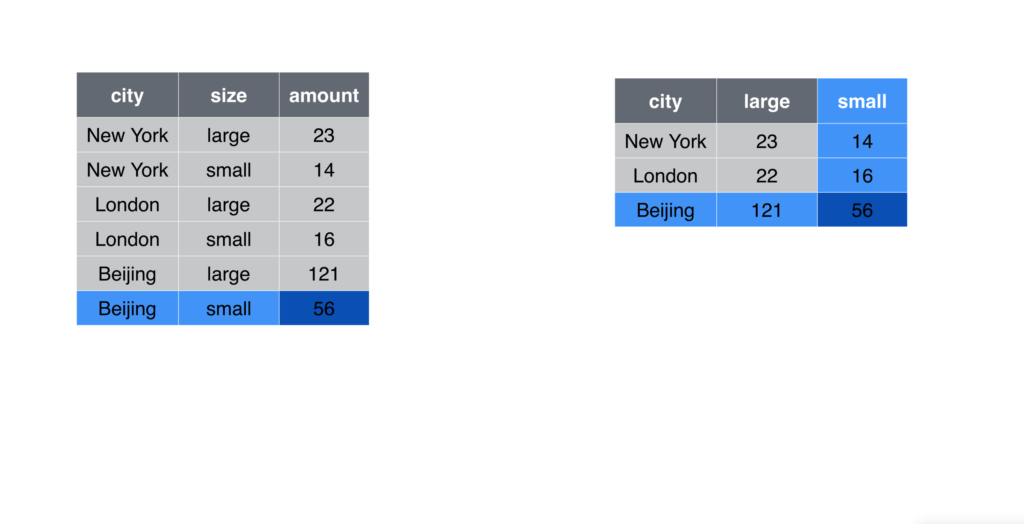
Data Wrangling: tidy data with pollution data set

Slide 47
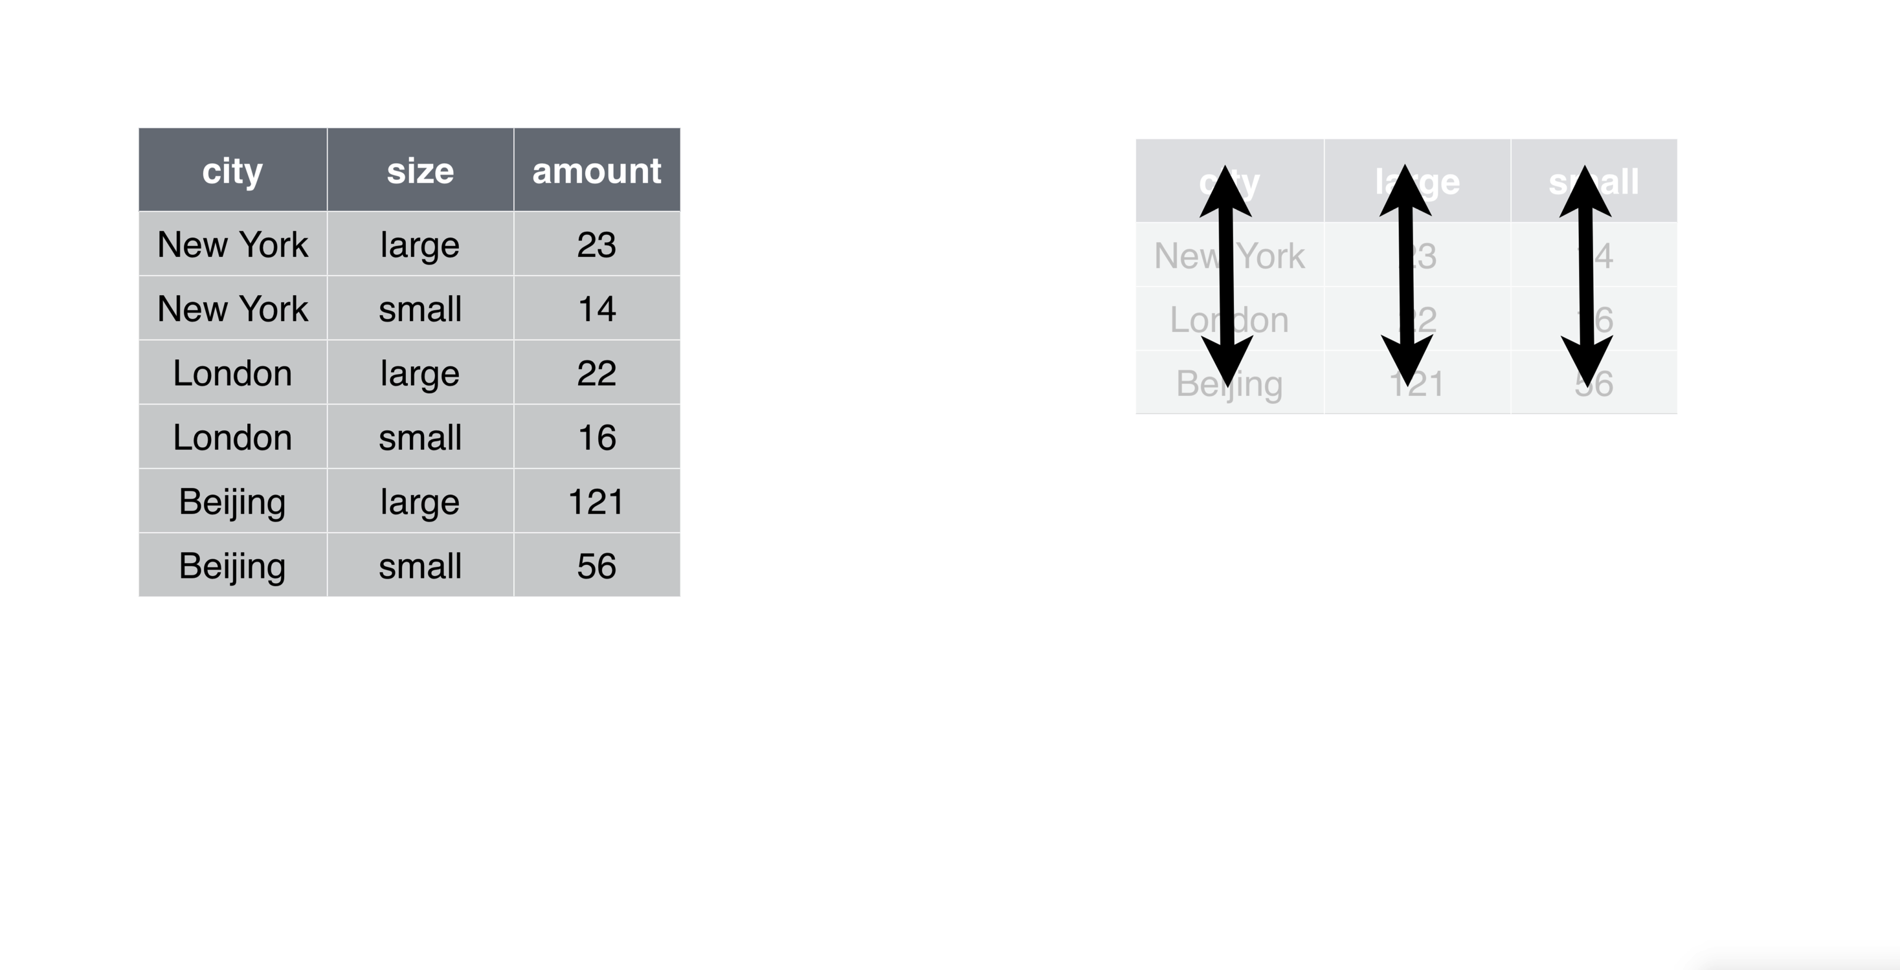
Data Wrangling: tidy data with pollution data set

Slide 48
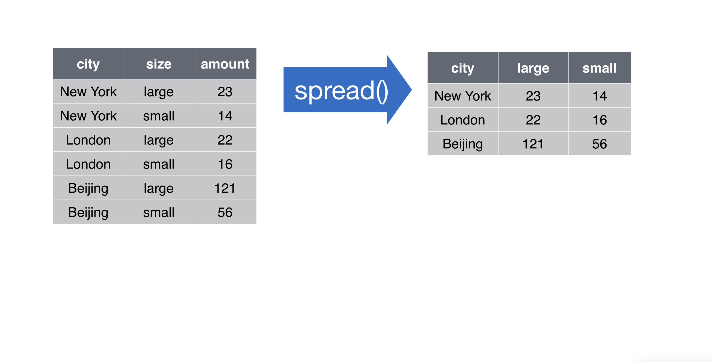
Data Wrangling: tidy data with pollution data set

Slide 49
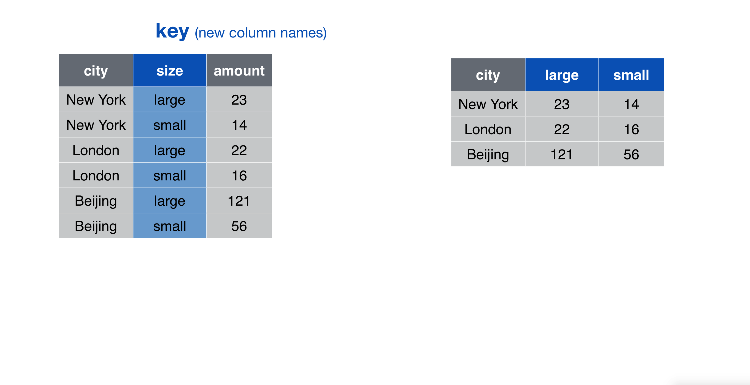
Data Wrangling: tidy data with pollution data set

Slide 50
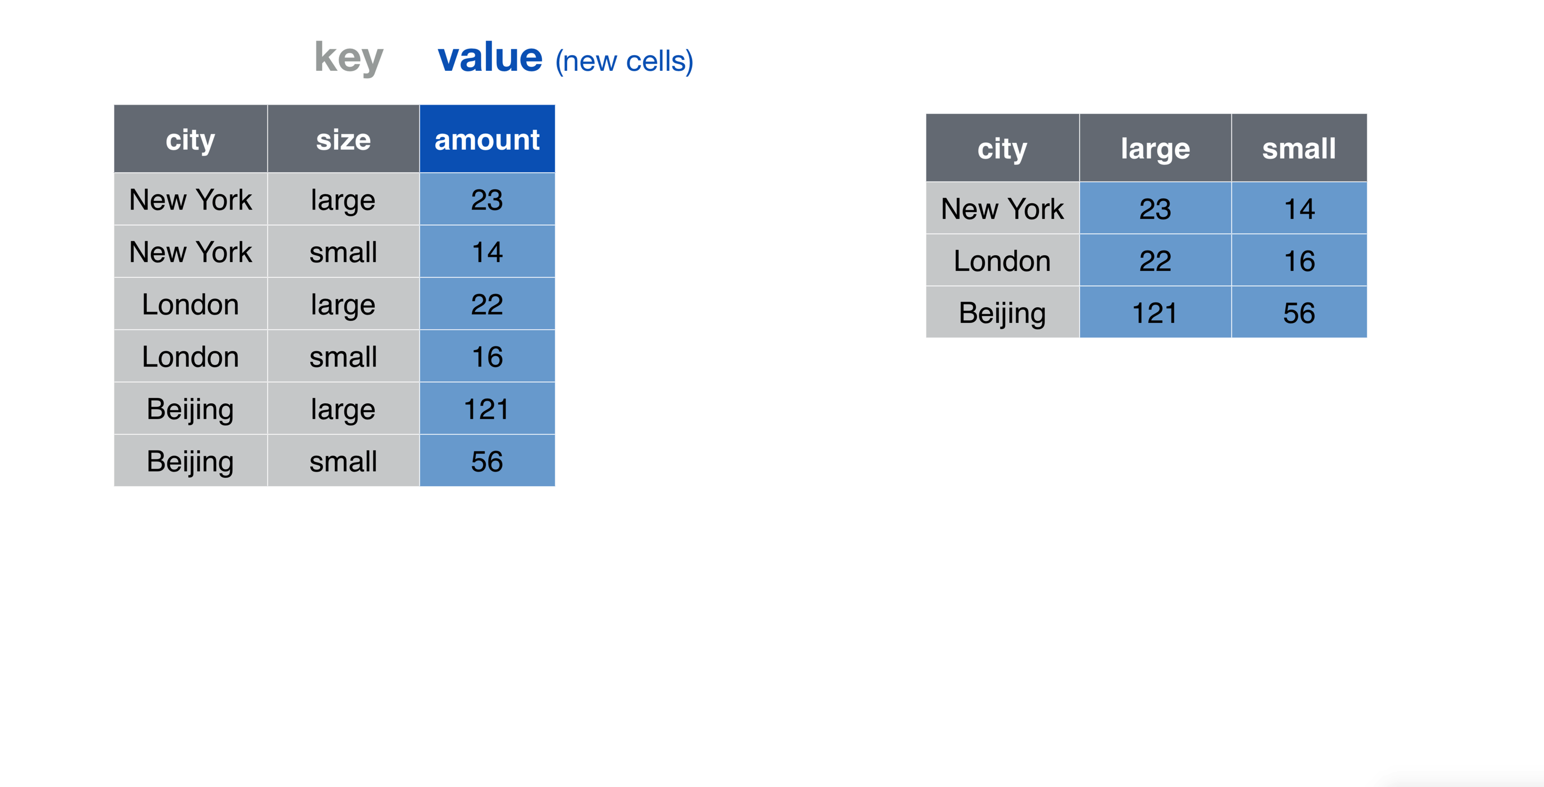
Data Wrangling: tidy data with pollution data set

Slide 51
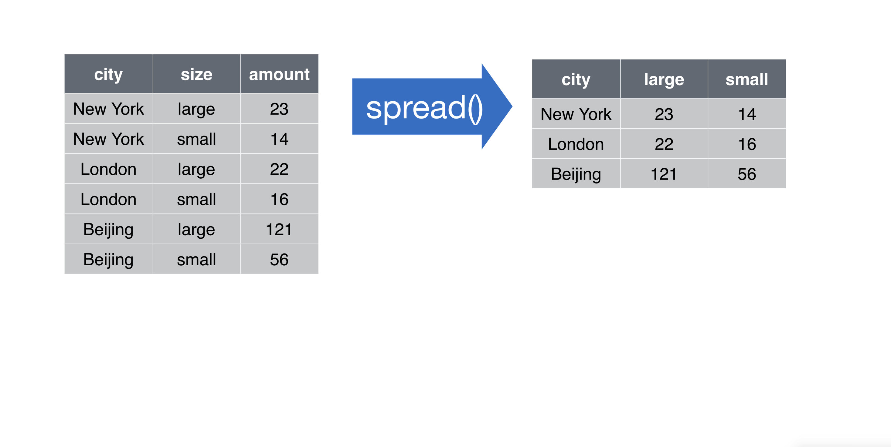
Data Wrangling: tidy data with pollution data set

Slide 52
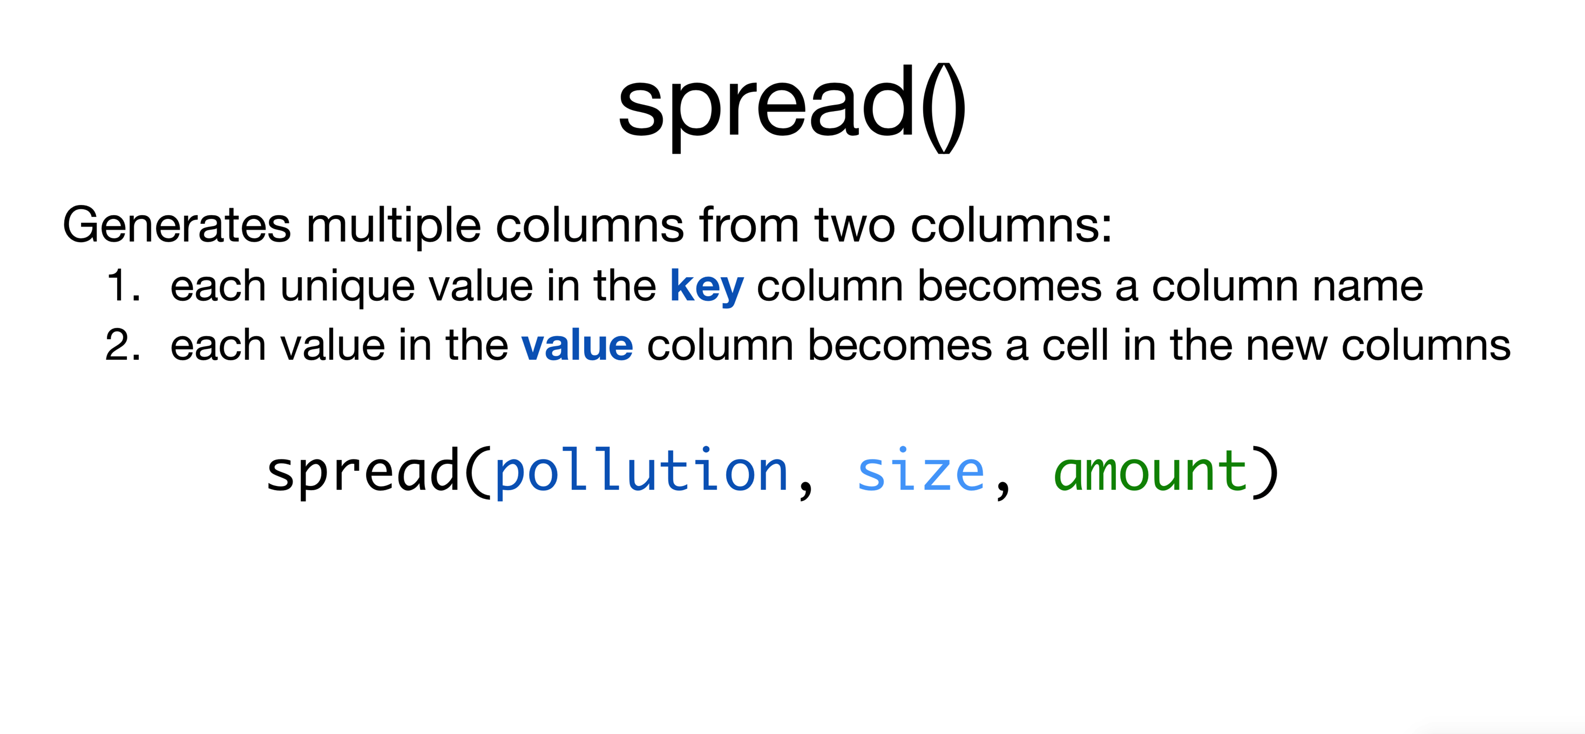
Data Wrangling: tidy data with pollution data set

Slide 53
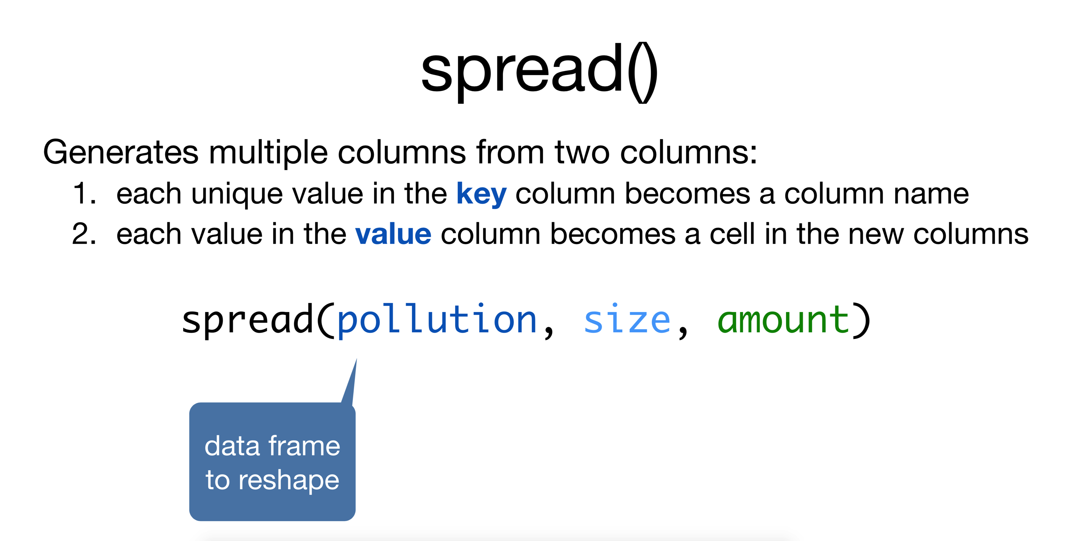
Data Wrangling: tidy data with pollution data set

Slide 54

Data Wrangling: tidy data with pollution data set

Slide 55

Data Wrangling: tidy data with pollution data set

Slide 56

Data Wrangling: tidy data with pollution data set

Slide 57

Data Wrangling: tidy data with pollution data set

Slide 58

Data Wrangling: unite() and separate()

Slide 59

Data Wrangling: separate()

Slide 60

Data Wrangling: unite()

Slide 61

Data Wrangling: tidyr

Slide 62


Data Wrangling: dplyr

Slide 63

Data Wrangling: dplyr operations to access information

Slide 64

Data Wrangling: select()

Slide 65

Data Wrangling: select()

Slide 66

Data Wrangling: select()

Slide 67

Data Wrangling: select()

Slide 68

Data Wrangling: filter()

Slide 69

Data Wrangling: filter()

Slide 70

Data Wrangling: filter()

Slide 71

Data Wrangling: mutate()

Slide 72

Data Wrangling: mutate()

Slide 73

Data Wrangling: summarise()

Slide 74

Data Wrangling: summarise()

Slide 75

Data Wrangling: summarise()

Slide 76

Data Wrangling: arrange()

Slide 77

Data Wrangling: arrange()

Slide 78

Data Wrangling: arrange()

Slide 79

Data Wrangling: arrange()

Slide 80

Data Wrangling: arrange()

Slide 81


An aside: The pipe operator %>%

Slide 82

Reading in datasets for %>% aside
tb = read.csv(“datasets/tb.csv”)

Slide 83

The pipe operator: %>%

Slide 84

The pipe operator: %>%

Slide 85

The pipe operator: %>%

Slide 86

The pipe operator: %>%

Slide 87

The pipe operator: %>%

Slide 88

The pipe operator: %>%

Slide 89

The pipe operator: %>%

Slide 90

The pipe operator: %>%

Slide 91


Slide 92

We can go from one tbl to a smaller tbl with summary measures

Slide 93

We can go from one tbl to a smaller tbl with summary measures

Slide 94

We can go from one tbl to a smaller tbl with summary measures

Slide 95

We can organize tbls by groups based on a column

Slide 96

We can organize tbls by groups based on a column

Slide 97

We can go from one tbl to a smaller tbl with summary measures

Slide 98

We can go from one tbl to a smaller tbl with summary measures

Slide 99

We can go from one tbl to a smaller tbl with summary measures

Slide 100

We can go from one tbl to a smaller tbl with summary measures

Slide 101

We can go from one tbl to a smaller tbl with summary measures

Slide 102

We can go from one tbl to a smaller tbl with summary measures

Slide 103

We can go from one tbl to a smaller tbl with summary measures

Slide 104

We can go from one tbl to a smaller tbl with summary measures

Slide 105

We can go from one tbl to a smaller tbl with summary measures

Slide 106

We can go from one tbl to a smaller tbl with summary measures

Slide 107

We can go from one tbl to a smaller tbl with summary measures

Slide 108


Joining Data

Slide 109


Reading in datasets for new examples
y = read.csv(“datasets/y.csv”)
z = read.csv(“datasets/z.csv”)

Slide 110

Combining Data Sets in dplyr

Slide 111

Combining Data Sets in dplyr

Slide 112

Combining Data Sets in dplyr

Slide 113

Combining Data Sets in dplyr

Slide 114

Combining Data Sets in dplyr

Slide 115


Reading in datasets for new examples
songs = read.csv(“datasets/songs.csv”)
artists = read.csv(“datasets/artists.csv”)

Slide 116

Combining Data Sets in dplyr

Slide 117

Combining Data Sets in dplyr

Slide 118

Combining Data Sets in dplyr

Slide 119

Combining Data Sets in dplyr

Slide 120

Further Learning

